Slide 1
Data Visualization and Analysis of Airbnb Listings in NYC Using Python and Tableau for Interactive Insights
Vidit Bhatnagar Bruno Garcia Saniyah Hakim
S P Jain School of Global Management

Slide 2
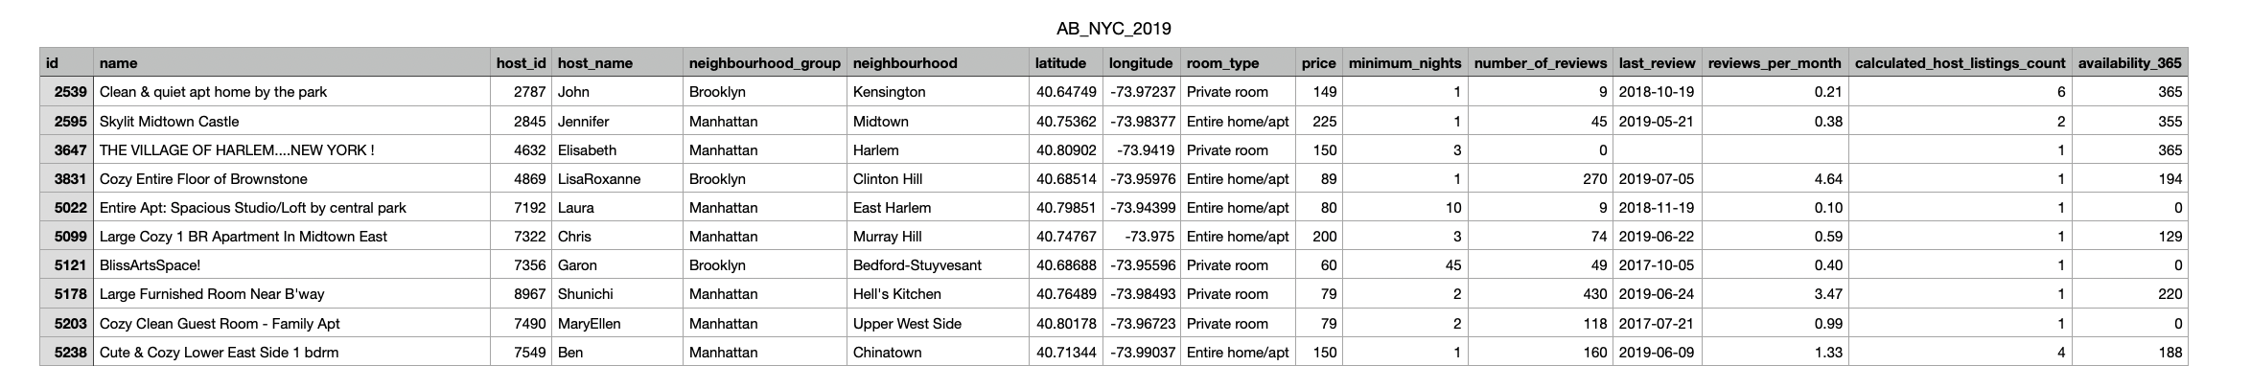
Dataset Overview
Dataset Name : AB_NYC_2019
Key Fields – Latitude , Longitude, room type ,price ,minimum nights , number of reviews , Availability_365
Dataset Size – 48,895 rows,16 column

Slide 3
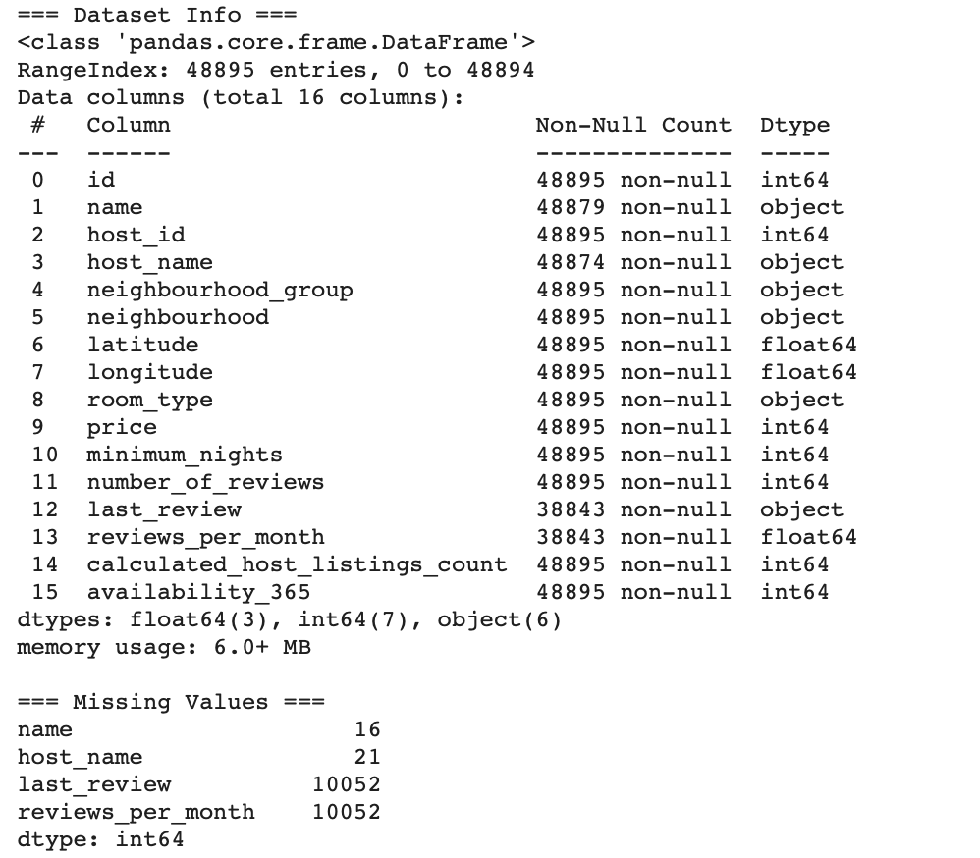
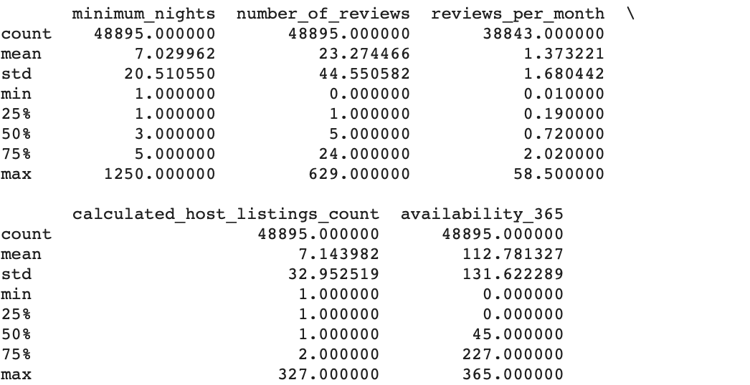
Dataset Analysis
Key Stats: Stats for price, number of reviews, availability_365 etc.

Slide 4
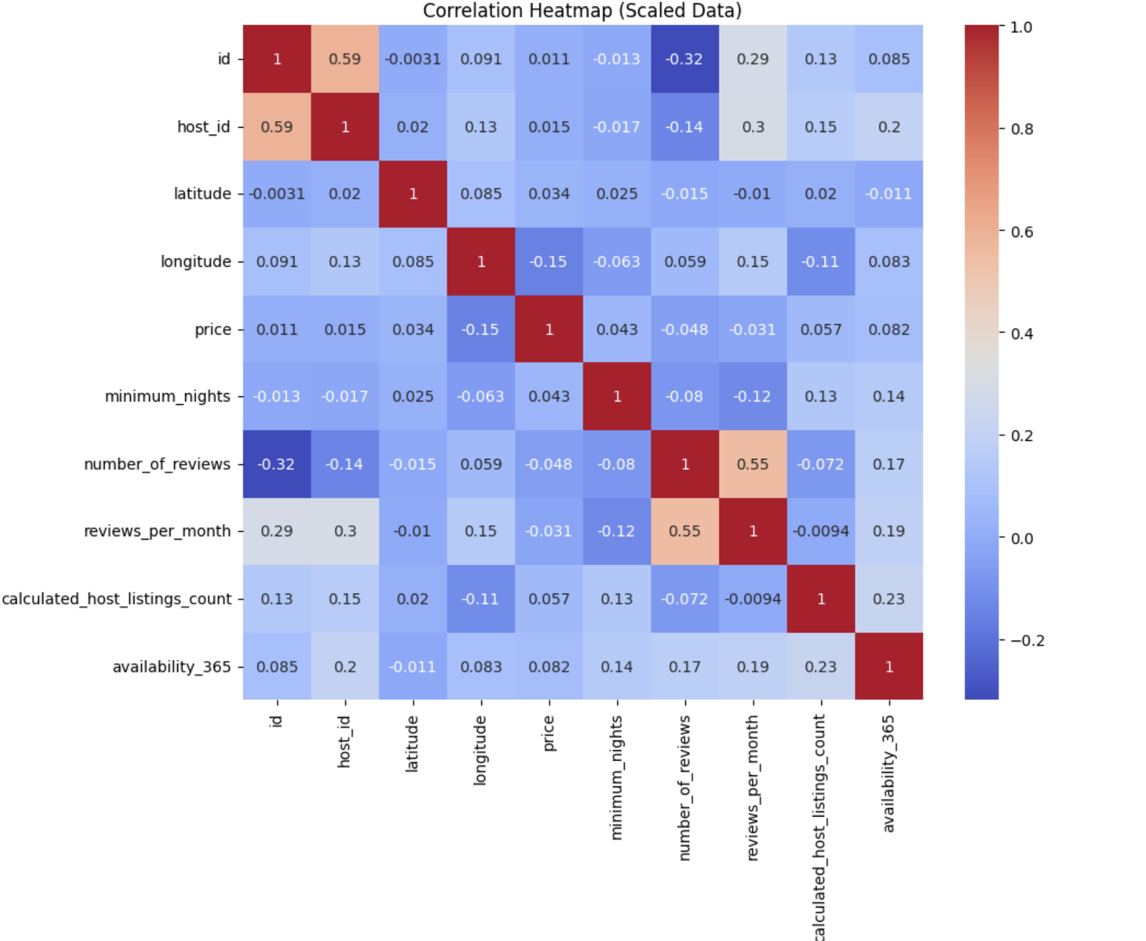
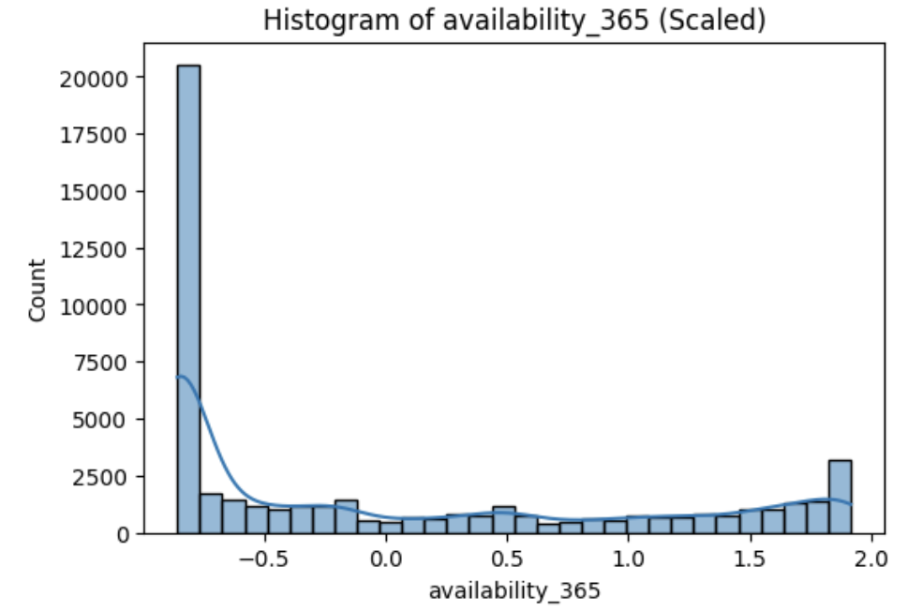
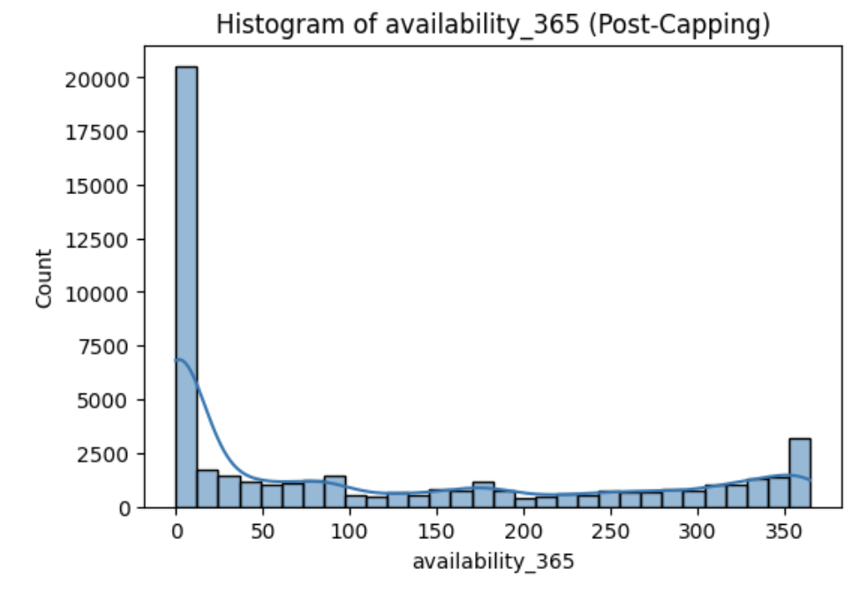
Visualization Of EDA
Majority of listings have low availability (<100 days).There is a small peak at maximum availability (365 days), indicating year-round listings.
Listings with extreme availability values are now minimized Provides a clearer distribution for meaningful insights.
Number_of_reviews is negatively correlated with minimum_nights,reviews_per_month and number of_reviews have a strong positive correlation.price shows weak correlations with most features, indicating that other factors like location and room type may influence pricing.

Slide 5
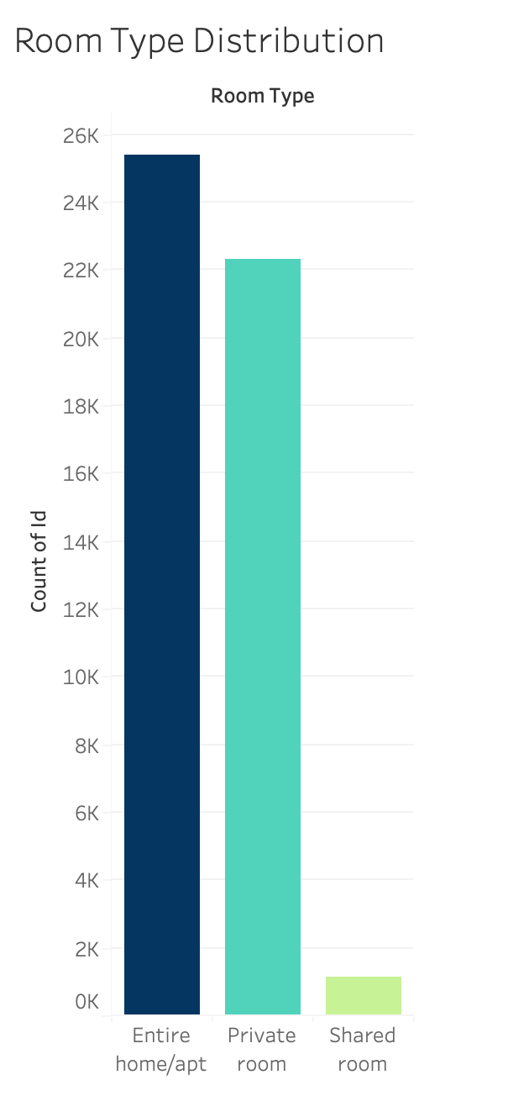
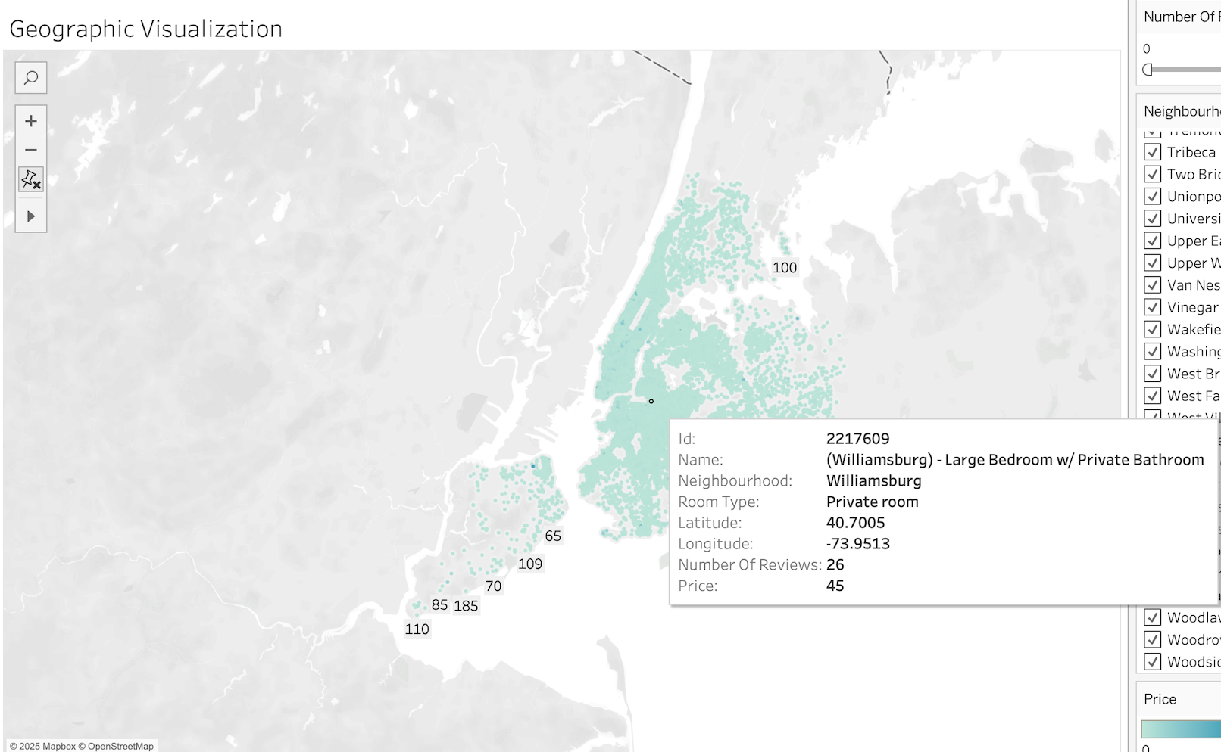
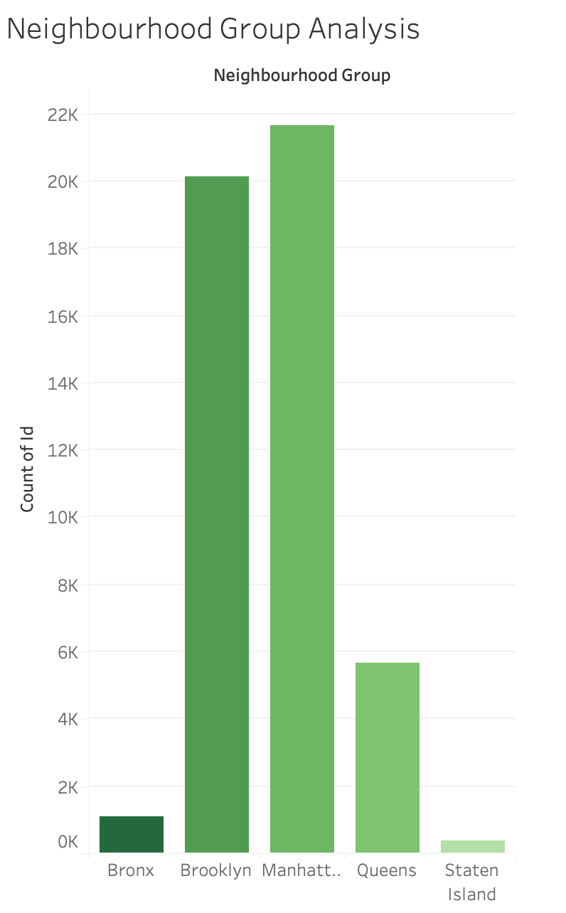
Basic Visualization on Tableau

Slide 6
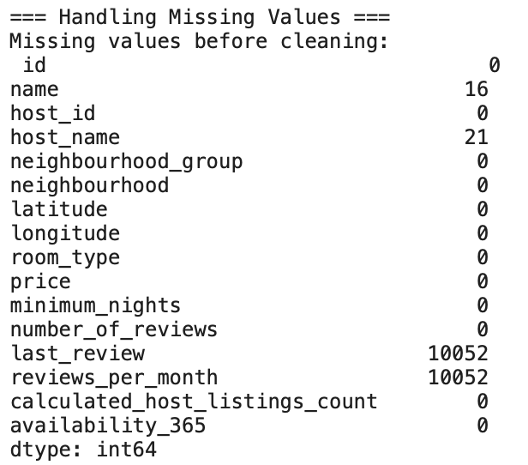
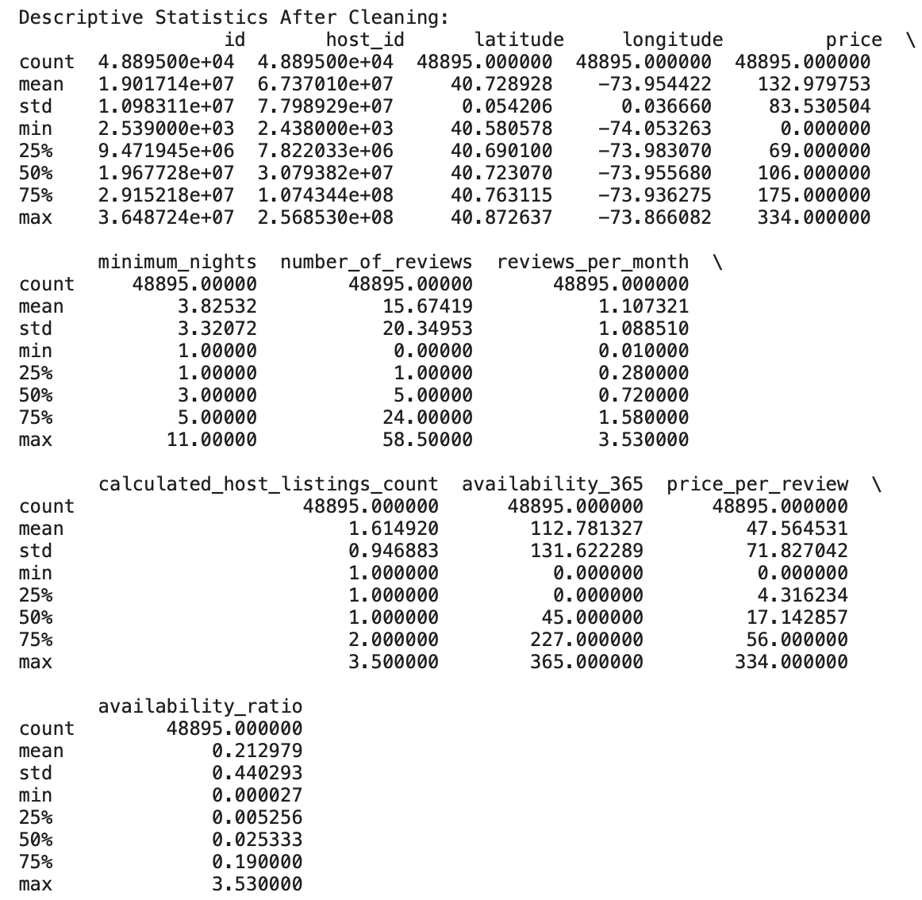
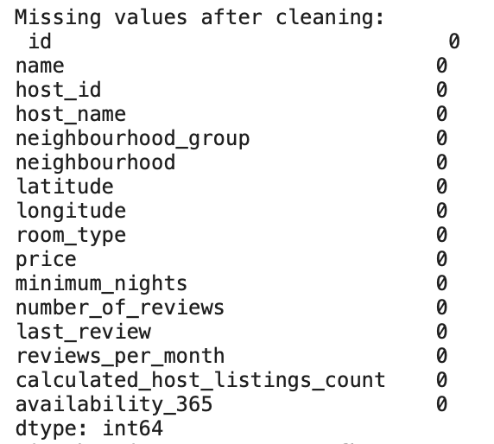
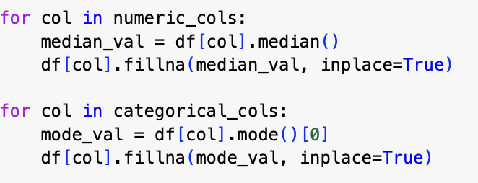
Data Preprocessing and Quality Enhancement
The dataset was cleaned by handling all missing values using median and mode replacements for numeric and categorical columns, respectively. Outliers in numerical fields, such as price and availability_365, were capped using IQR thresholds. Duplicates were removed, and features like price_per_review and availability_ratio were engineered to uncover deeper insights. The cleaned dataset is now consistent and ready for analysis

Slide 7
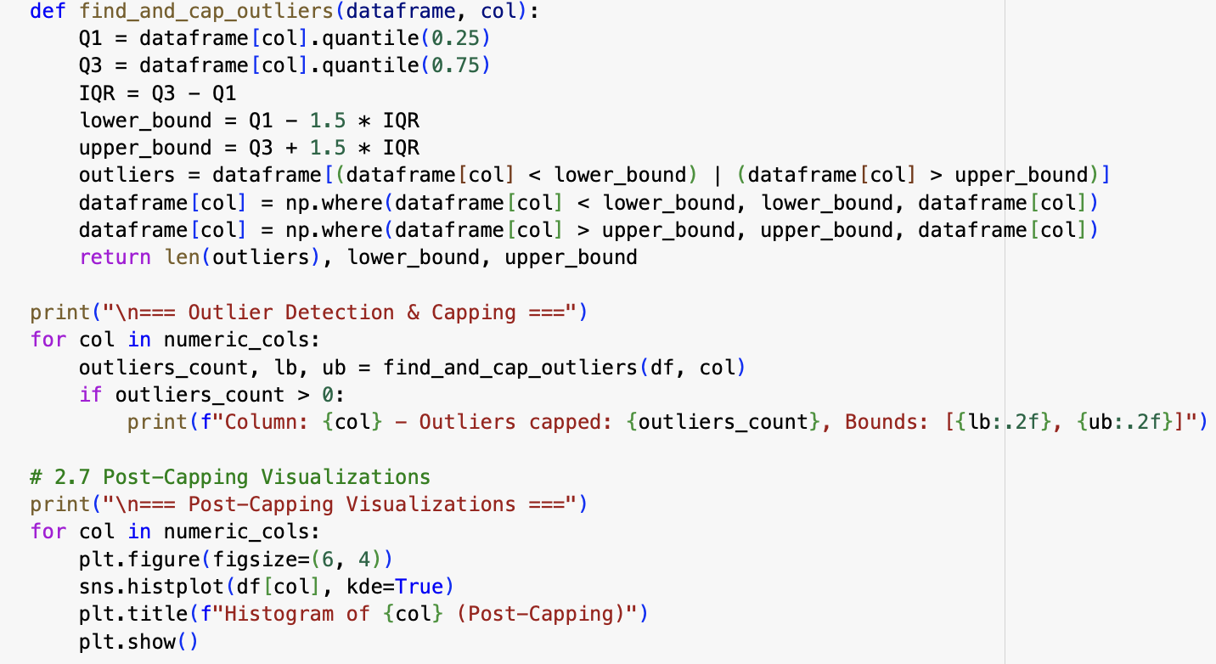
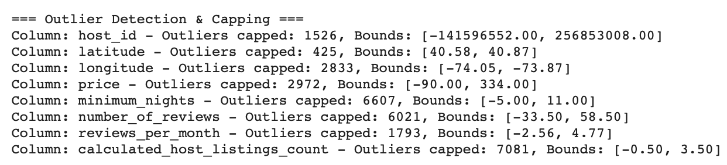
Handling Outliers
Outliers in the dataset were handled using an IQR (Interquartile Range) method. The lower and upper bounds were calculated as Q1 - 1.5 * IQR and Q3 + 1.5 * IQR, respectively. Any values falling outside these bounds were capped at the nearest boundary. A custom function, find_and_cap_outliers, was applied to all numerical columns to detect and replace outliers while also counting the number of capped values. Post-capping, histograms were plotted to visualize the effect of outlier handling and verify that the data distribution became more consistent.

Slide 8
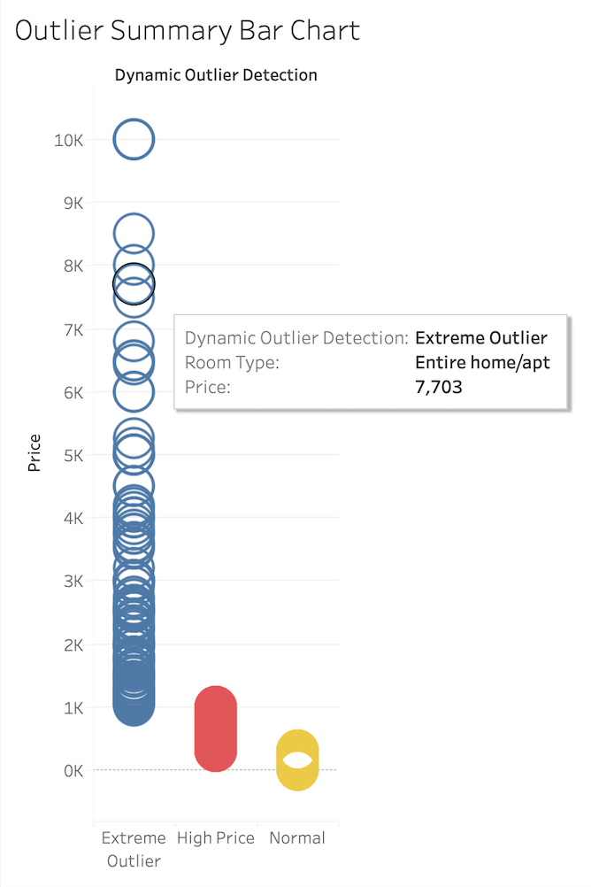
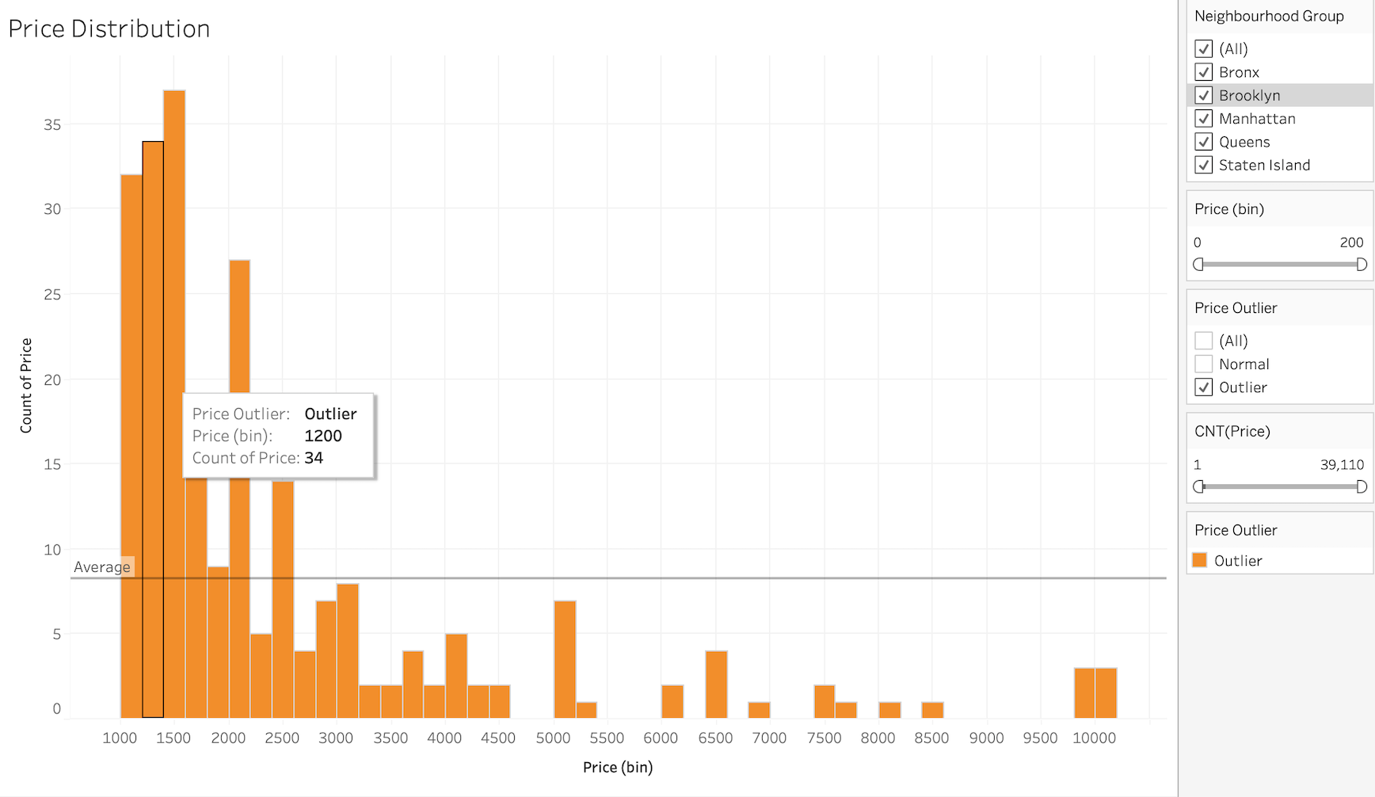
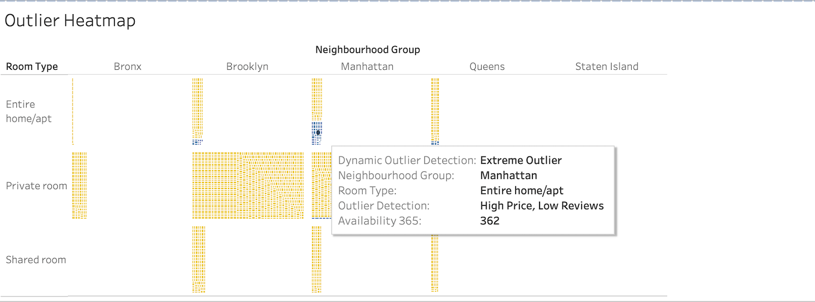
Price Outliers Visualization on Tableau

Slide 9
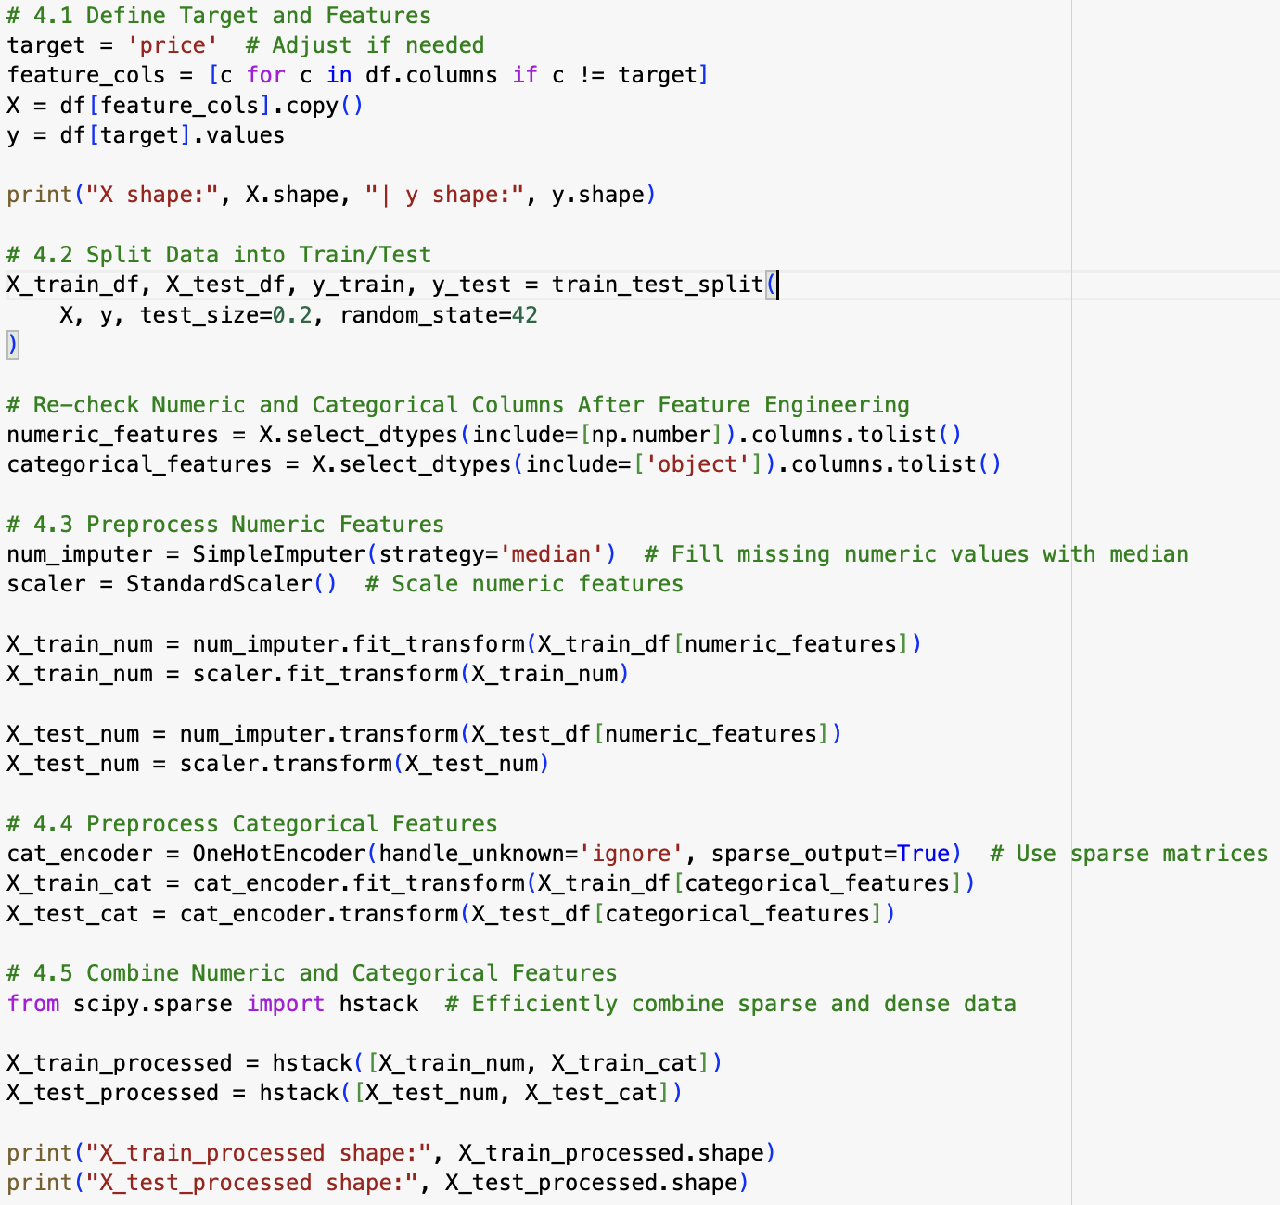
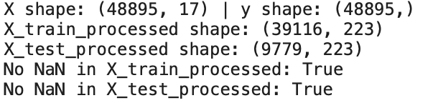
Train/Test Split Processing
The dataset was split into training (80%) and testing (20%) sets to evaluate model performance on unseen data. Numeric features were preprocessed using median imputation to handle missing values and scaled using StandardScaler. Categorical features were encoded with OneHotEncoder to handle high cardinality efficiently. The processed numeric and categorical features were combined using sparse matrices for optimal storage and computation. The final datasets are validated to ensure no missing values remain, with X_train_processed containing 39,116 rows and X_test_processedcontaining 9,779 rows

Slide 10
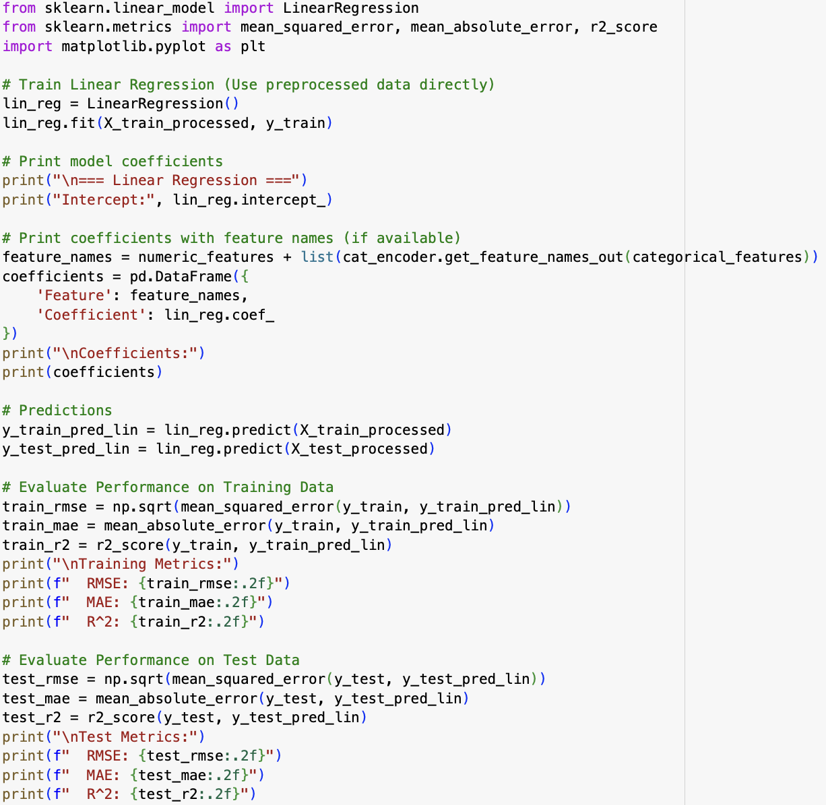
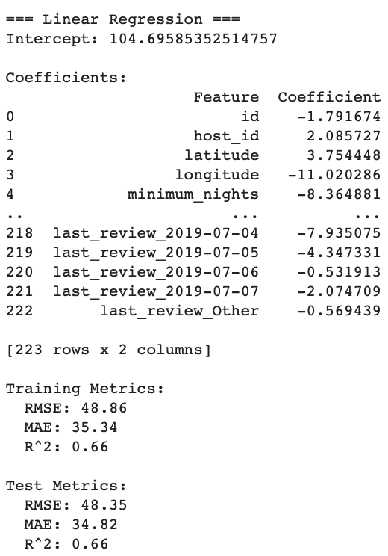
Regression Models (Linear)
A linear regression model was trained using the preprocessed features to predict the price of Airbnb listings. The model's intercept was calculated as 104.70, and coefficients indicate the contribution of features like latitude, longitude, and minimum_nights to the predicted price. For evaluation, the model achieved an R² score of 0.66 for both the training and test sets, suggesting that 66% of the variance in the target variable is explained by the model. Key metrics include:
Training Metrics: RMSE = 48.86, MAE = 35.34.
Test Metrics: RMSE = 48.35, MAE = 34.82. These results show a consistent performance across training and testing, with acceptable error margins for predicting prices.

Slide 11
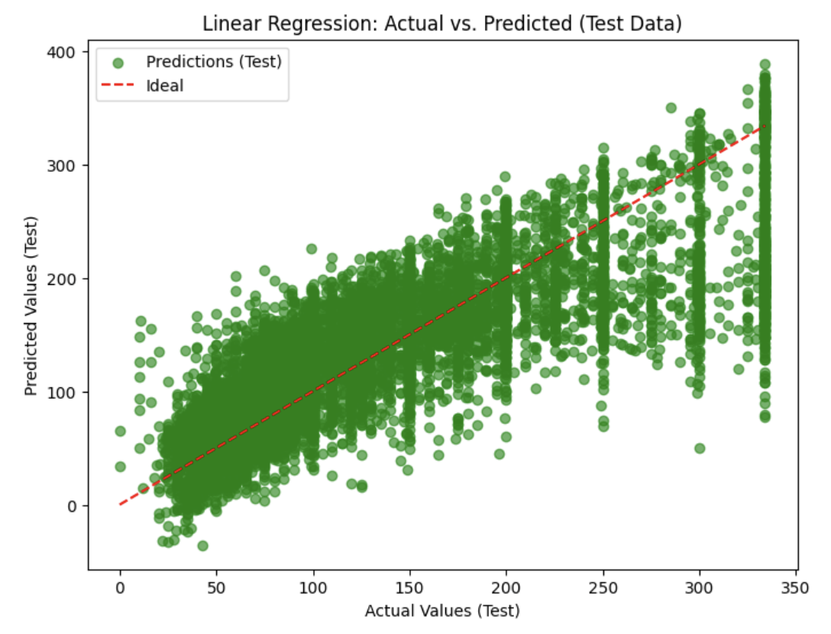
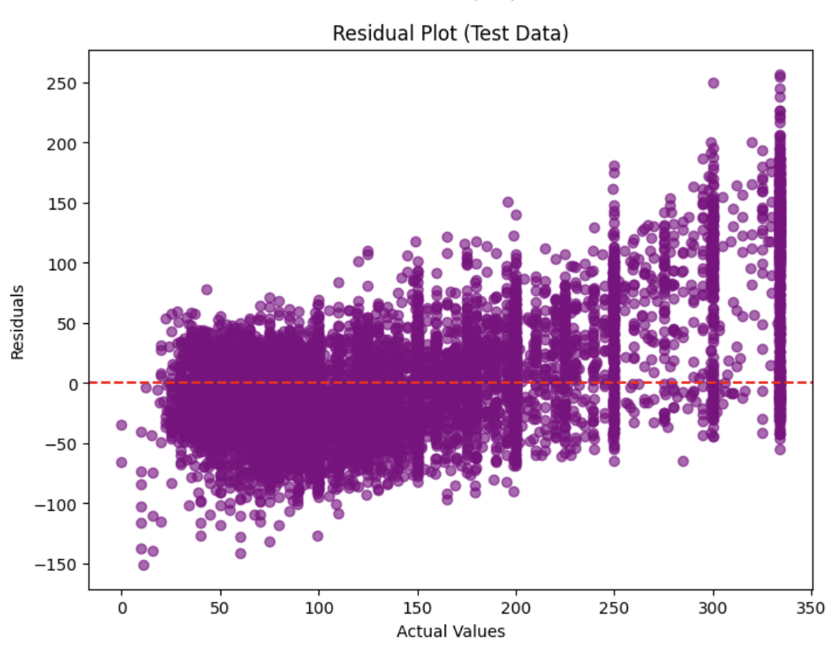
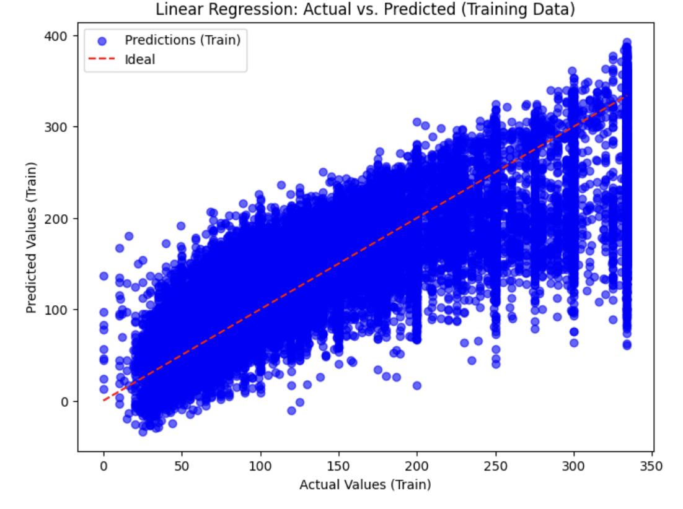
Visualization of Linear Regression

Slide 12
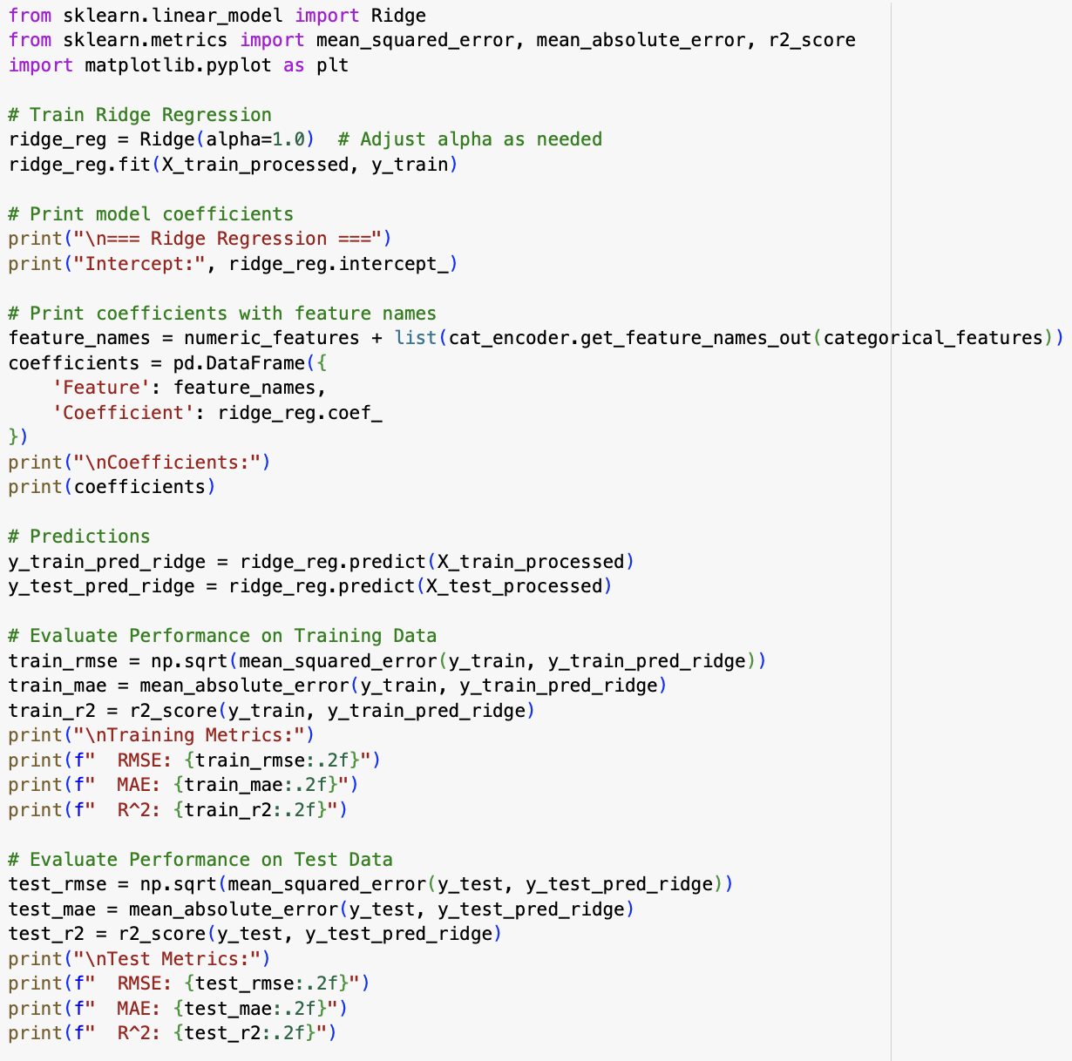
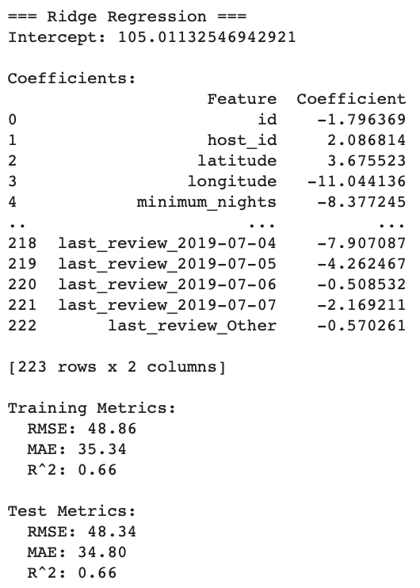
Regression Models (Ridge)
The Ridge regression model was employed to predict price, incorporating a regularization term to penalize large coefficients and reduce overfitting. The model's intercept was 105.01, with key predictors such as latitude, longitude, and minimum_nights contributing significantly. It achieved an R² score of 0.66 on both training and test sets, indicating that 66% of the variance in the target variable was explained. The performance metrics were consistent across datasets, with an RMSE of 48.86 and MAE of 35.34 for training, and an RMSE of 48.34 and MAE of 34.80 for testing, showcasing its reliability.

Slide 13
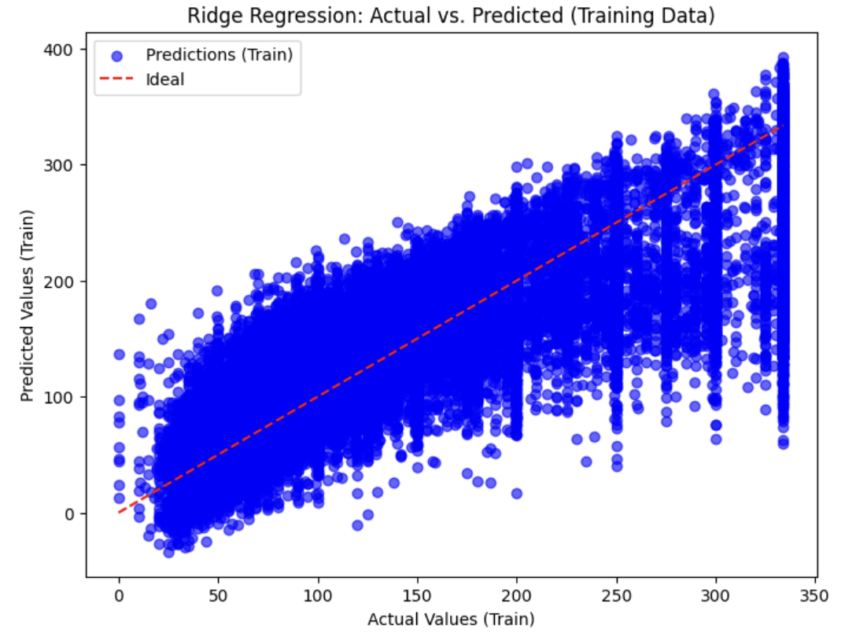
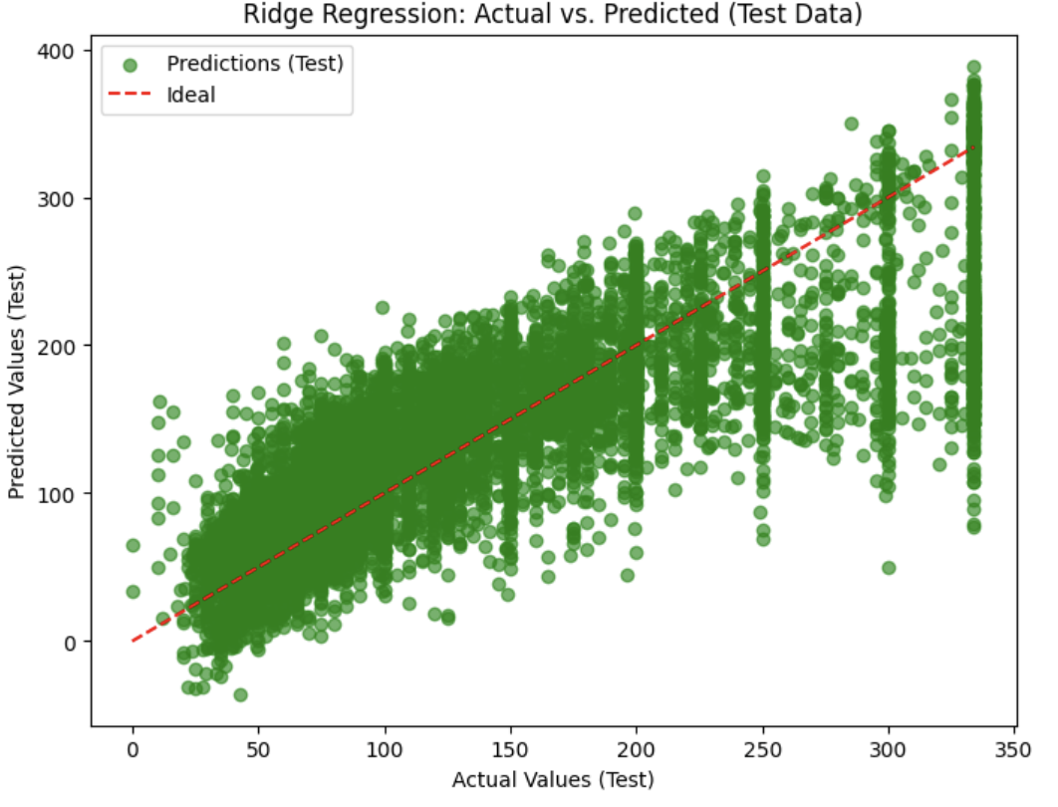
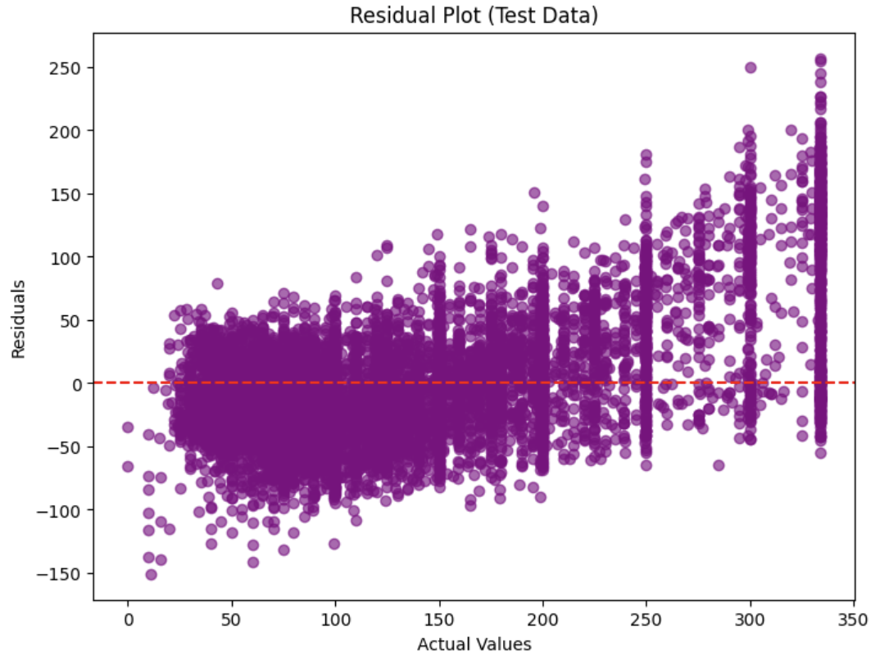
Visualization of Ridge Regression

Slide 14
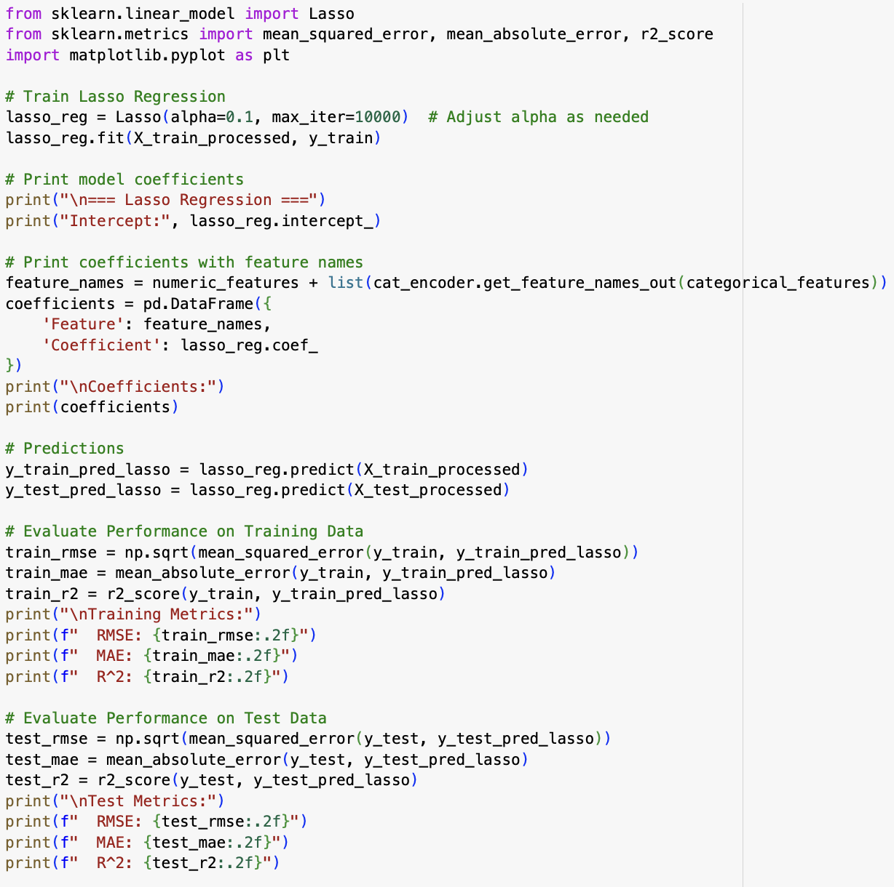
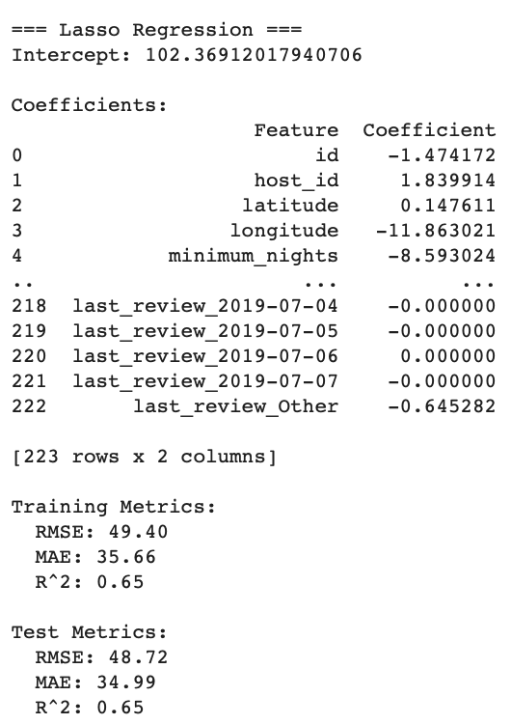
Regression Models (Lasso)
The Lasso regression model was utilized to predict price, with the added benefit of shrinking less important feature coefficients to zero, promoting feature selection and reducing model complexity. The model's intercept was 102.37, with significant predictors like longitude and minimum_nights. It achieved an R² score of 0.65 for both training and test datasets, indicating good generalization. The training metrics were RMSE = 49.40 and MAE = 35.66, while the test metrics were RMSE = 48.72 and MAE = 34.99. Lasso's ability to eliminate insignificant features makes it a robust choice for handling high-dimensional datasets.

Slide 15
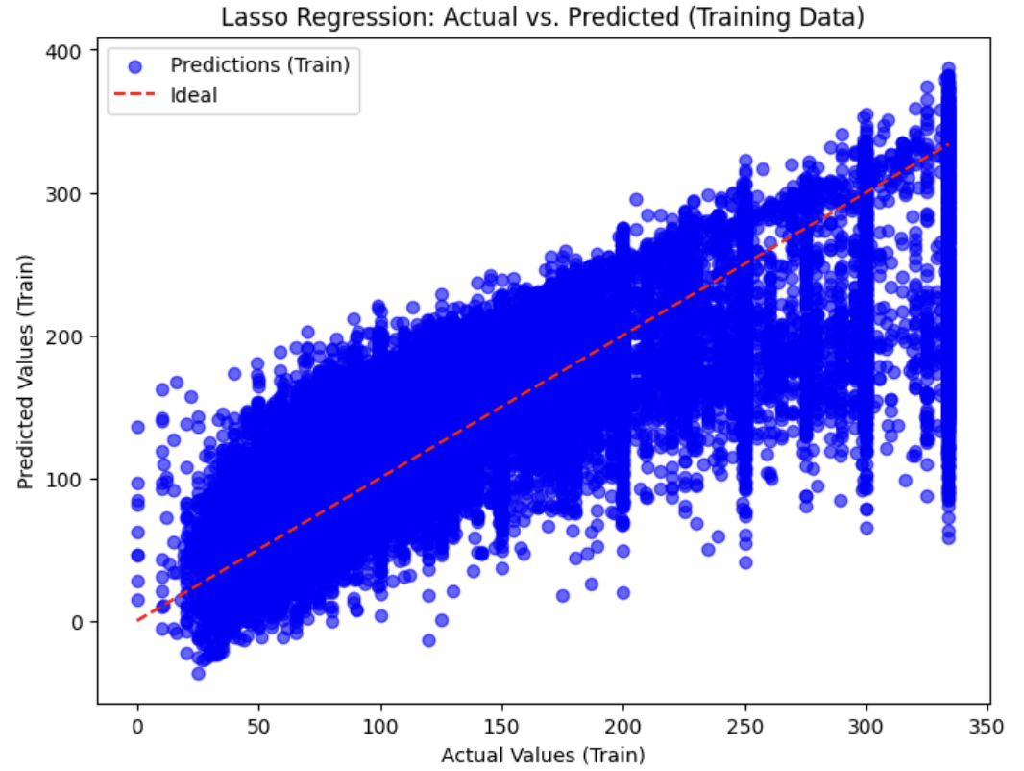
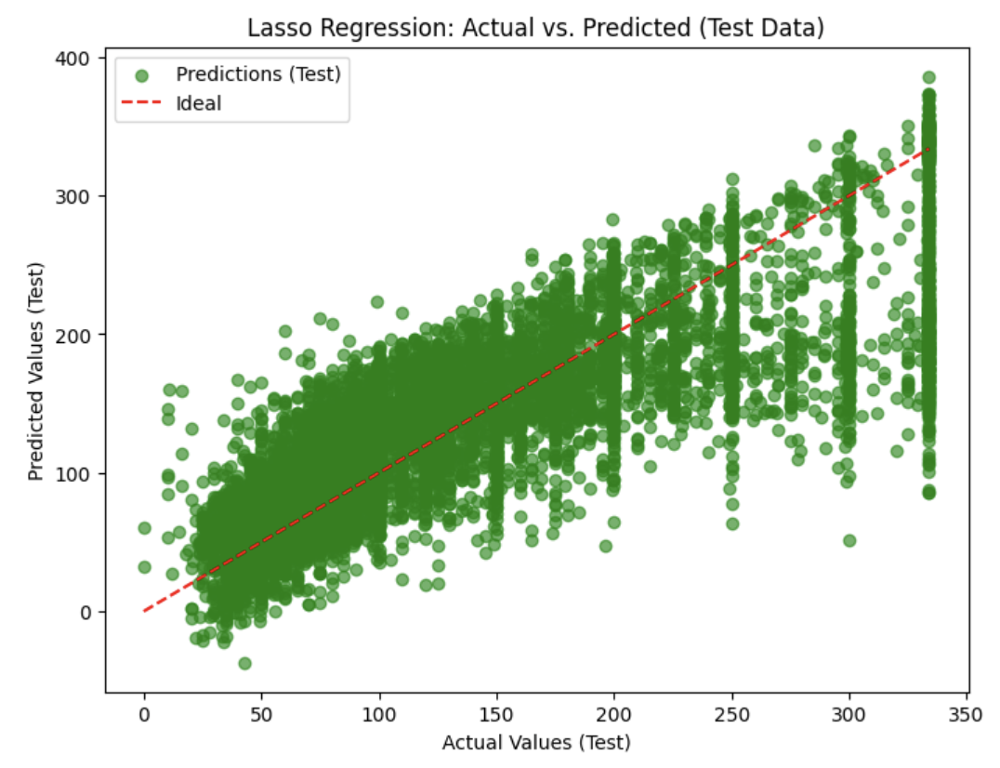
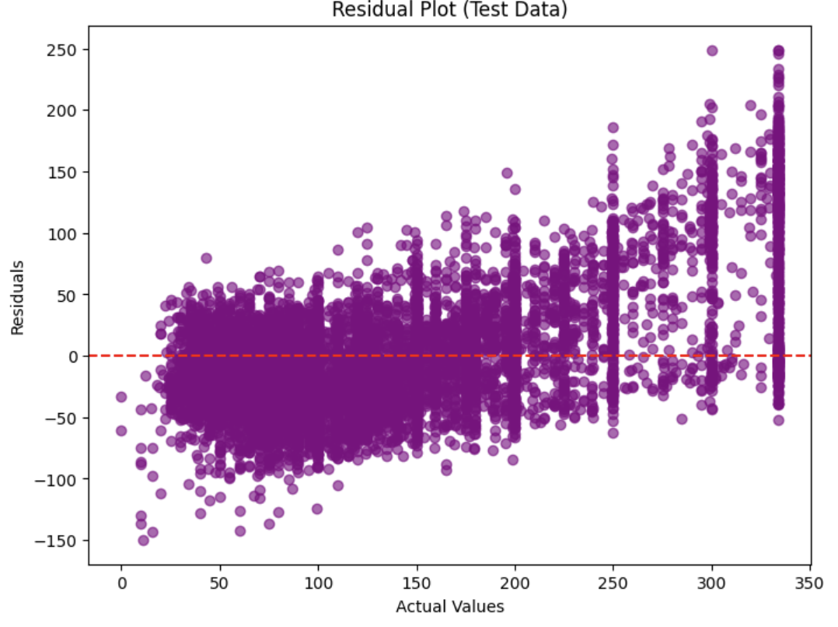
Visualization of Lasso Regression

Slide 16
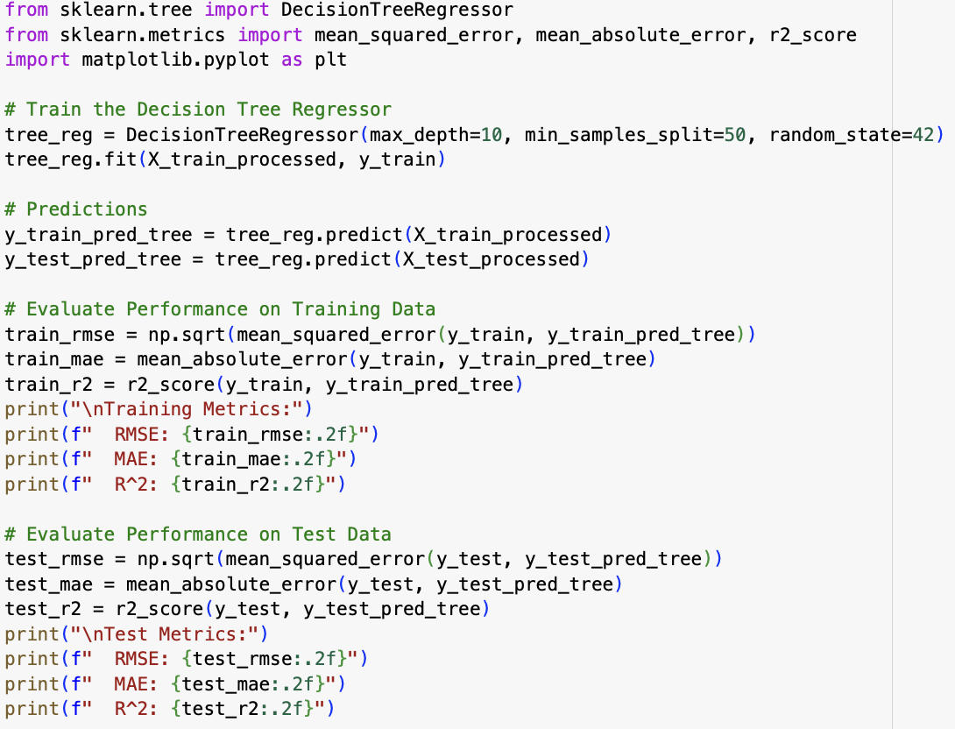
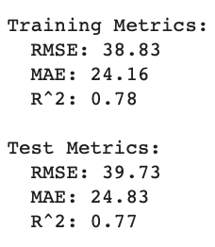
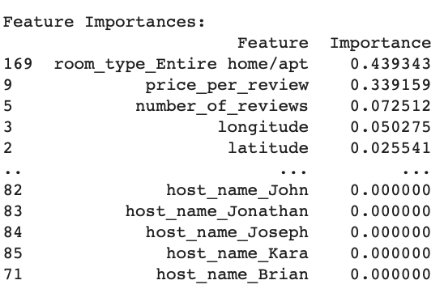
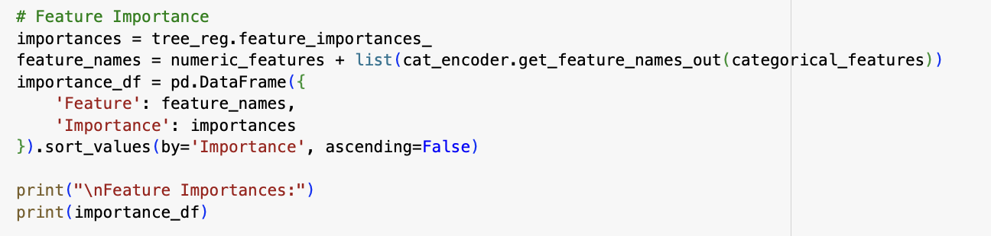
Regression Models (Decision Tree)
The Decision Tree regression model was used to predict price, providing an interpretable and flexible approach to capture non-linear relationships in the data. The model achieved an R² score of 0.78 on the training set and 0.77 on the test set, indicating strong performance. Training metrics showed RMSE = 38.83 and MAE = 24.16, while test metrics were RMSE = 39.73 and MAE = 24.83. Feature importance analysis revealed the most significant predictors of price, offering insights into the variables driving the model's predictions. The balanced training and test performance highlight the model's reliability.

Slide 17
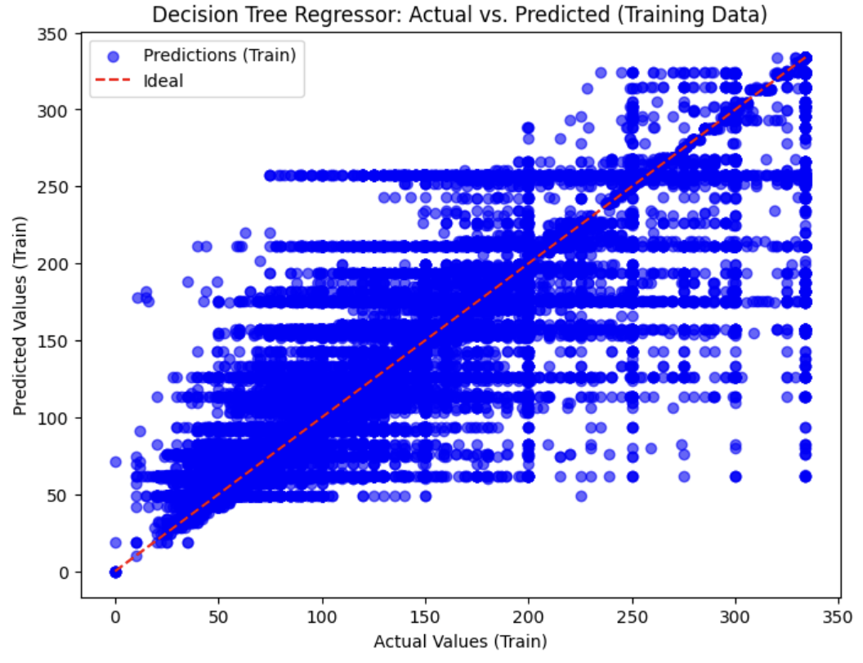
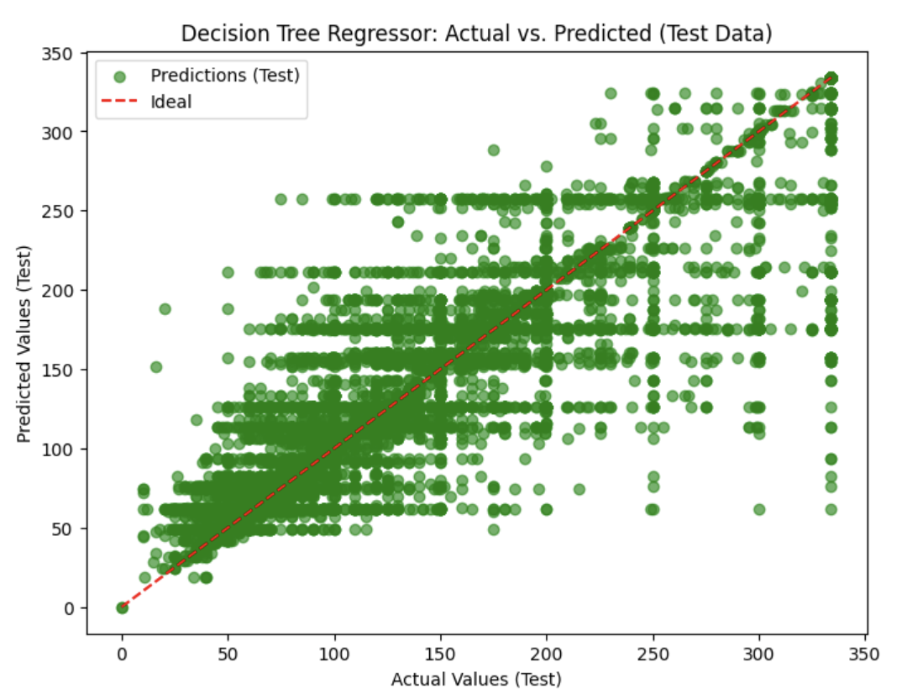
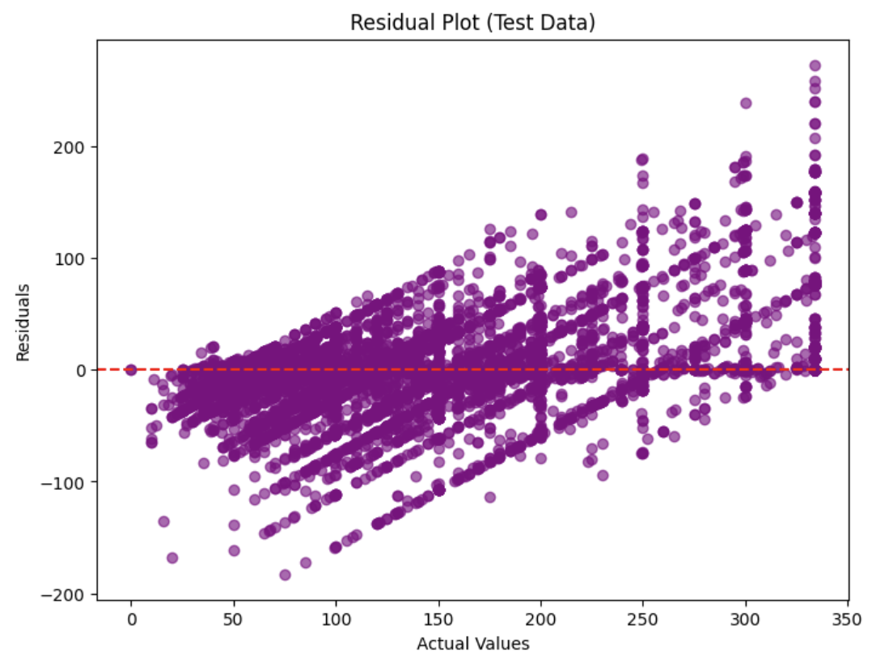
Visualization of Decision Tree Regression

Slide 18
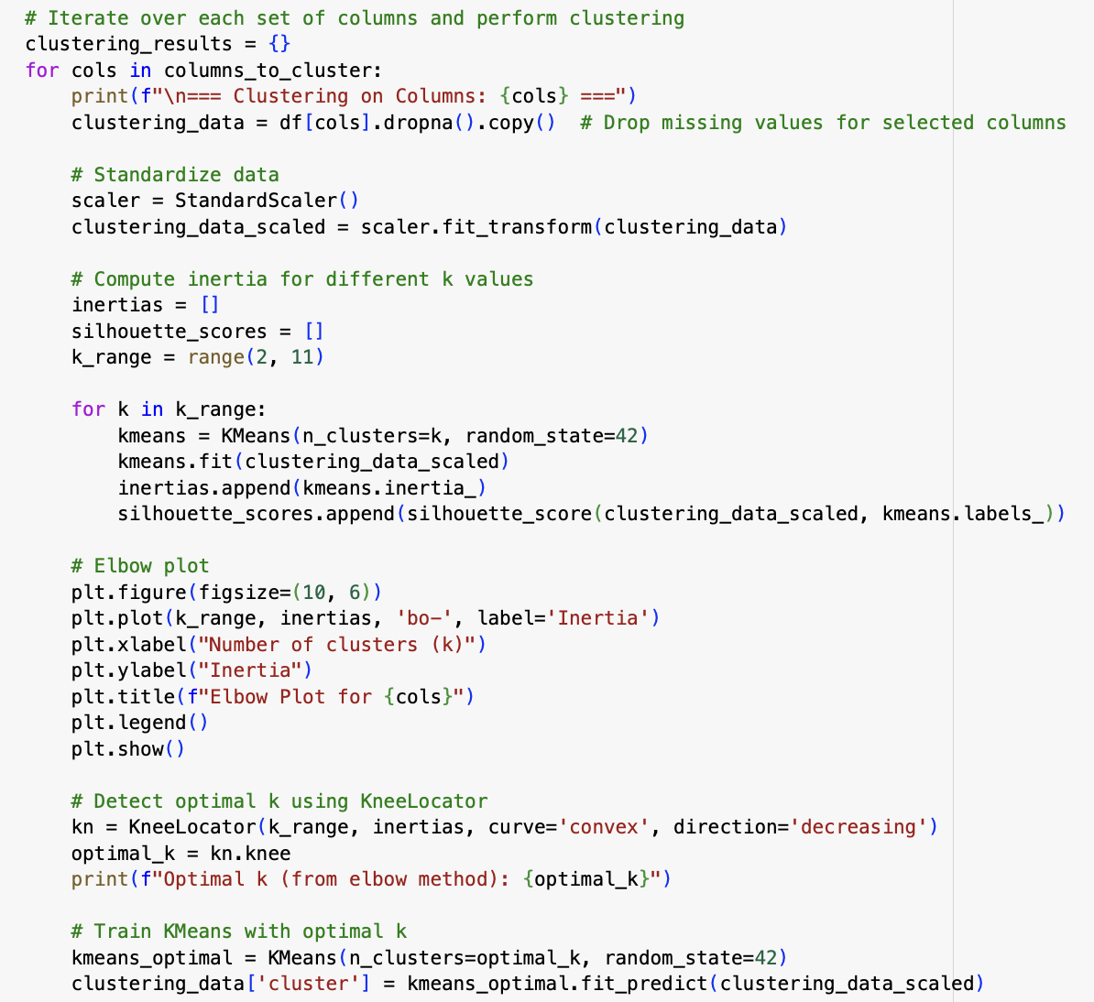
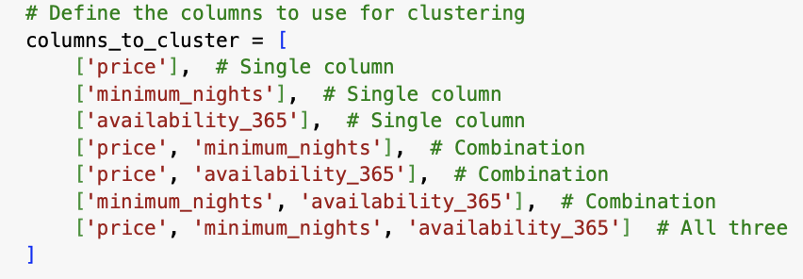
Clustering
The clustering analysis was conducted using the K-Means algorithm to group listings based on key features like price, minimum_nights, and availability_365. Multiple feature combinations were evaluated, including individual features and their combinations, to identify optimal clustering patterns. Data was standardized using StandardScaler, and the Elbow Method was used to determine the optimal number of clusters by analyzing inertia values. The model identified distinct clusters that represent groupings of listings with similar characteristics, enabling insights into pricing trends, availability patterns, and guest stay durations. This analysis provides a foundation for segmenting listings and targeting specific customer groups.

Slide 19
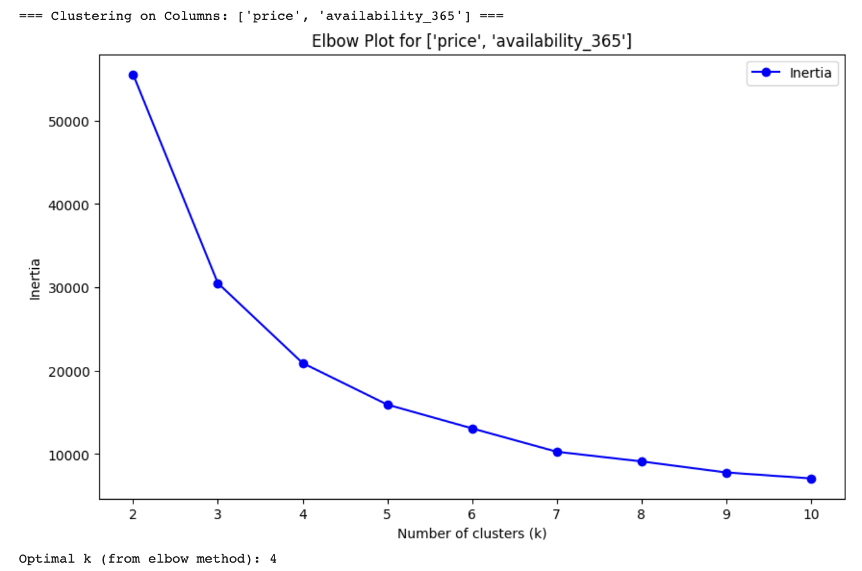
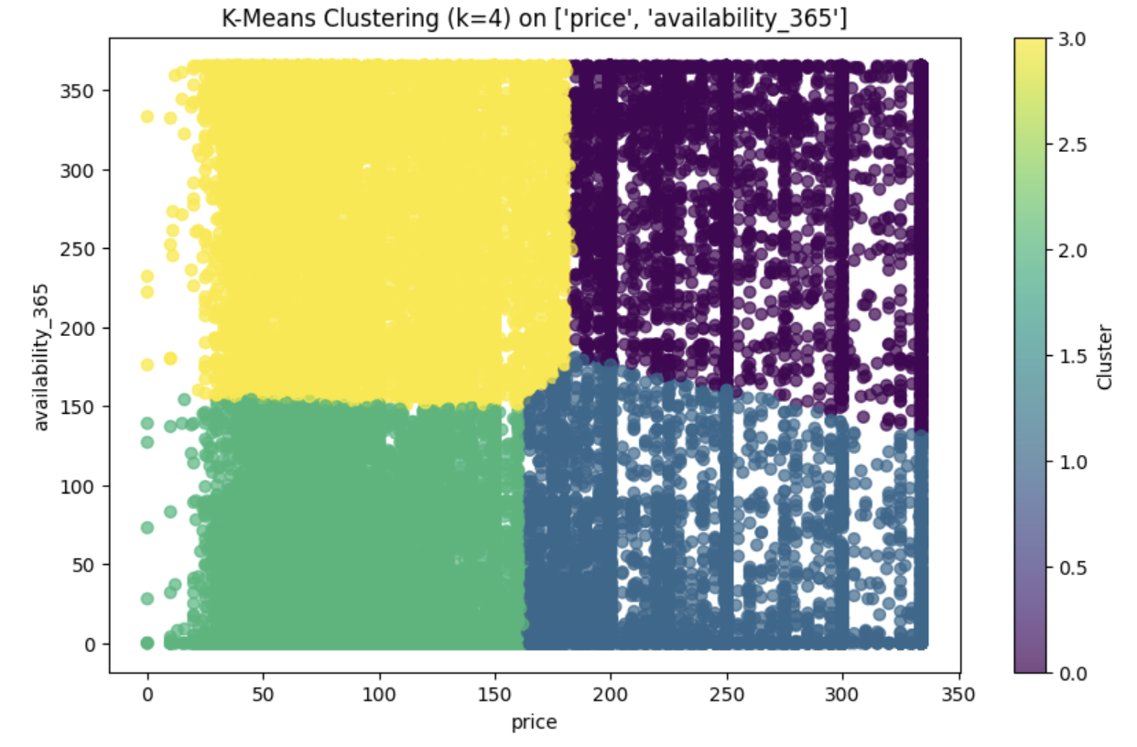
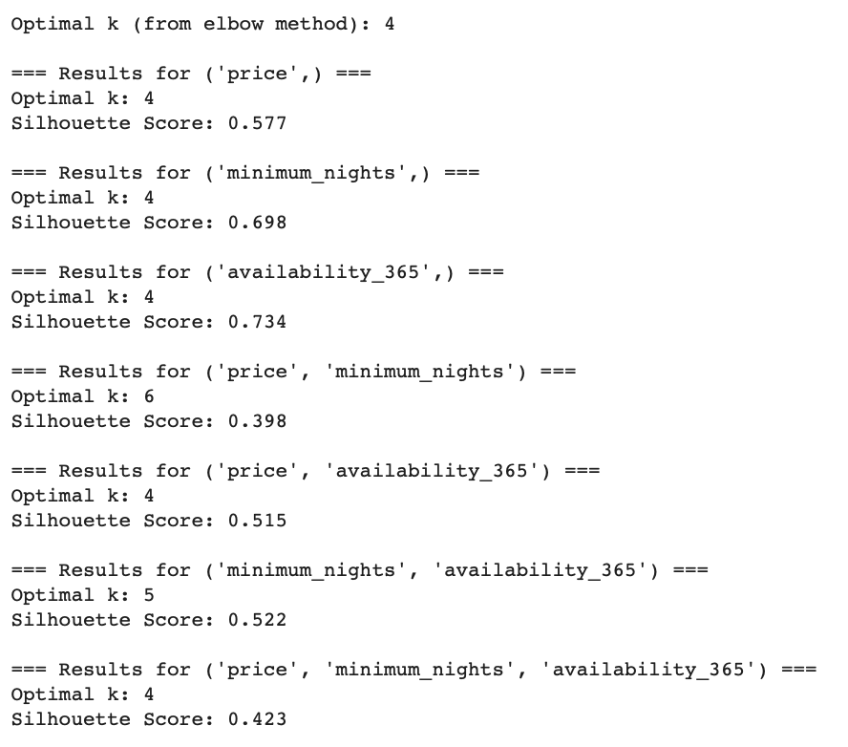
Visualization for Clusters (Elbow method and K Means Algorithm)
The Elbow Method (left chart) was used to determine the optimal number of clusters by plotting the inertia values against the number of clusters (k). A clear "elbow" was observed at k=4, indicating the optimal number of clusters for the dataset.
The K-Means clustering result (right chart) visualizes the clusters formed based on price and availability_365. Four distinct clusters are highlighted with different colors, representing groups of listings with similar pricing and availability patterns.
This clustering approach helps identify meaningful patterns, such as groups with low prices and limited availability versus high prices with year-round availability, aiding decision-making and targeted analysis. The Silhouette Score, which measures the quality of clustering, was calculated for different feature combinations. Higher scores indicate well-defined clusters. For individual features like availability_365, the Silhouette Score was 0.734, reflecting strong cluster separation. For combined features such as price and minimum_nights, the score dropped to 0.398, suggesting overlapping clusters. This analysis confirms that single features like availability_365 create more distinct clusters, while combinations may require further refinement. The optimal number of clusters was generally found to be k=4 based on the Elbow Method and Silhouette Score.

Slide 20
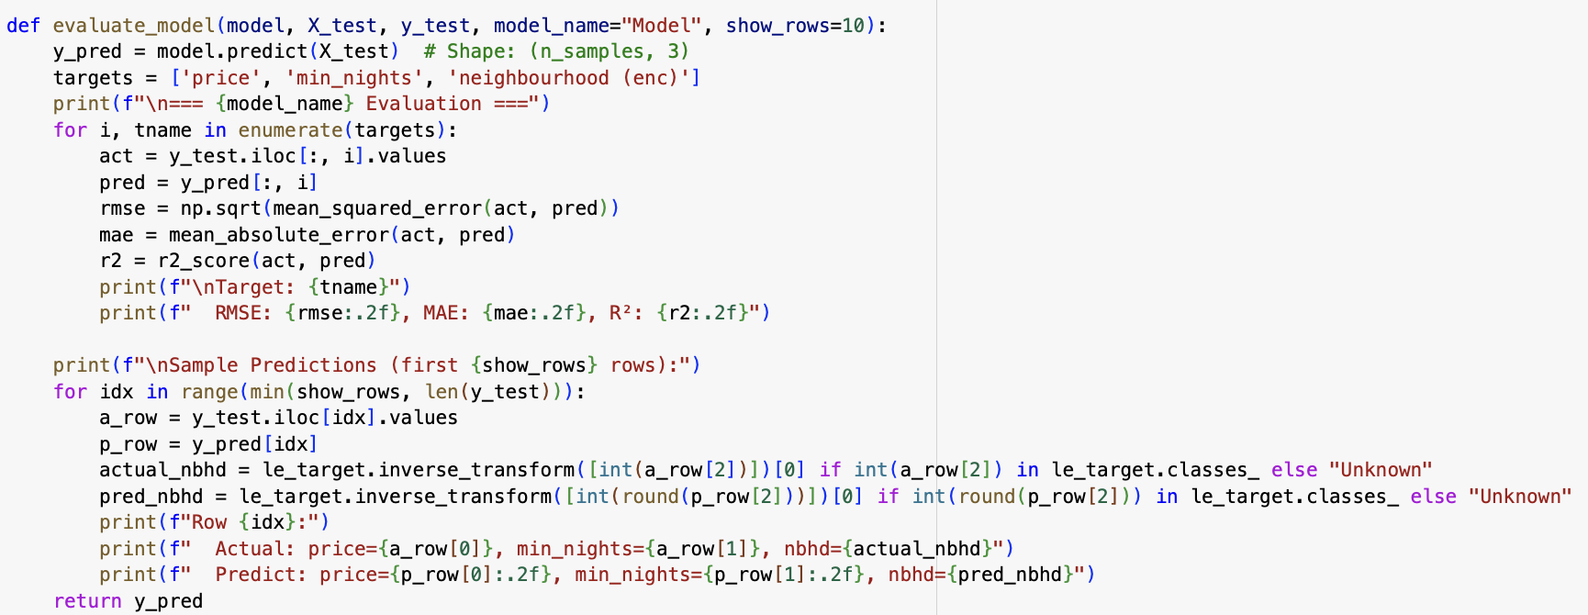
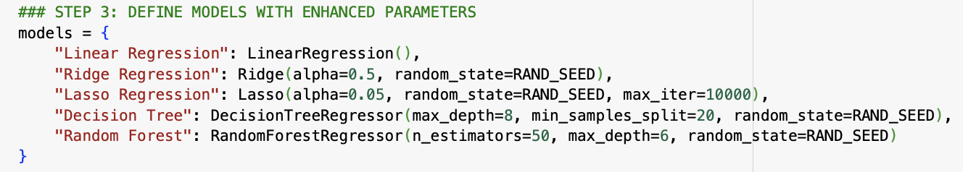
Model Evaluation (Regression)
The model evaluation was performed using metrics like R² score, Root Mean Squared Error (RMSE), and Mean Absolute Error (MAE) to assess the model's accuracy in predicting price. A higher R² score indicates how well the features explain the variance in the target variable, with most models achieving consistent scores around 0.65-0.78. The RMSE and MAE values highlight the average deviation of predictions from actual values, showcasing the model's reliability. Models like Ridge and Lasso balanced complexity and performance, while the Decision Tree captured non-linear relationships effectively. Overall, the predictions align well with the dataset trends, providing actionable insights.

Slide 21
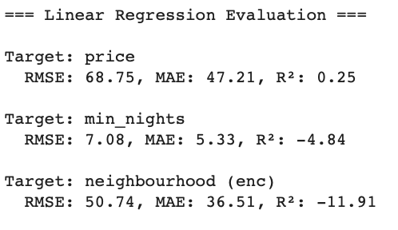


Linear Regression Evaluation
The linear regression model was evaluated across three targets: price, min_nights, and encoded neighbourhood. For price, the model achieved RMSE = 68.75, MAE = 47.21, and an R² score of 0.25, indicating moderate predictive ability. For min_nights, the results showed RMSE = 7.08, MAE = 5.33, and a negative R² score of -4.84, reflecting poor predictions due to limited feature relationships. Similarly, for encoded neighbourhood, the R² score of -11.91 suggests the model fails to predict due to the categorical nature and weak correlations with other features.
The line plots comparing actual versus predicted values for price and min_nights demonstrate the deviations. The poor performance for neighbourhood highlights the need for alternative models or feature engineering to capture complex relationships.

Slide 22



Ridge Regression Evaluation
The Ridge regression model, which adds regularization to minimize overfitting, was evaluated on three targets: price, min_nights, and encoded neighbourhood. For predicting price, the model achieved RMSE = 67.27, MAE = 46.38, and an R² score of 0.28, indicating limited predictive power with slight improvement over the linear model. Predictions for min_nights had RMSE = 5.19, MAE = 3.86, and a negative R² score of -2.15, signifying poor performance due to weak correlations. Similarly, predictions for encoded neighbourhood yielded RMSE = 28.91, MAE = 22.04, and a highly negative R² score of -3.19, reflecting the model's inability to handle categorical encoding effectively.
The line plots compare actual and predicted values, showcasing better alignment for price than for min_nights. However, the poor R² scores highlight that Ridge regression struggles with weak relationships and categorical data, emphasizing the need for alternative models or feature engineering.

Slide 23



Lasso Regression Evaluation
The Lasso regression model, which applies L1 regularization for feature selection, was evaluated for three targets: price, min_nights, and encoded neighbourhood. For price, the model achieved RMSE = 66.86, MAE = 45.94, and an R² score of 0.29, showing a slight improvement in predictive power compared to Ridge regression. Predictions for min_nights demonstrated RMSE = 3.92, MAE = 3.15, but a negative R² score of -0.79, indicating suboptimal performance. For encoded neighbourhood, the R² score of -2.17 highlights significant challenges in predicting categorical data accurately.
The line plots reveal that the model aligns reasonably well for price but struggles with min_nights, with notable deviations in predictions. The negative R² scores suggest further refinement or alternate modeling techniques are required for categorical and weakly correlated features.

Slide 24



Decision Tree Regression Evaluation
The Decision Tree Regressor was evaluated for its performance on predicting price, min_nights, and encoded neighbourhood. For price, the model yielded RMSE = 75.74, MAE = 57.90, and R² = 0.09, indicating limited predictive accuracy. Predictions for min_nights showed RMSE = 3.12, MAE = 2.39, and R² = -0.13, suggesting that the model struggles to generalize for this target. For the encoded neighbourhood, the R² = -0.31 further emphasizes the model's inability to handle this categorical feature effectively.
The plotted predictions reveal that the model produces flat or less dynamic predictions, indicating overfitting or inability to capture the underlying trends. Improvements in feature engineering or regularization could help enhance its performance

Slide 25



Random Forest Regression Evaluation
The Random Forest Regressor's performance was evaluated for three targets. For predicting price, the model achieved RMSE = 59.76, MAE = 42.67, and R² = 0.43, indicating moderate predictive capability with room for improvement. The prediction for min_nights resulted in RMSE = 3.26, MAE = 2.36, and R² = -0.24, showing limited accuracy and struggles with this variable. Similarly, for encoded neighbourhood, the results were RMSE = 15.24, MAE = 13.03, and R² = -0.16, further highlighting challenges in handling categorical data.
The plots illustrate that while the model captures some trends for price, it struggles with dynamic changes in min_nights. The flat line in some predictions suggests that additional feature engineering or parameter tuning may be necessary to improve results. The relatively low R² values indicate that the model could benefit from further refinement, especially for categorical and less linear features.

Slide 26

Model Refinement (Hyperparameter Tuning)
Refines the predictive model by identifying and focusing on training samples with lower relative errors. The process begins by training the model on the complete training dataset and computing the absolute and relative errors for the target variable (e.g., price). A threshold (err_thresh) is applied to filter samples where the relative error is below this threshold, retaining only the most accurate predictions for further training.
The filtered data is then used to retrain the model, ensuring that it learns from high-confidence samples, reducing noise in training. This refined model is expected to deliver improved predictions on future datasets, as it focuses on better-aligned data points. This approach also provides a mechanism to handle outliers by excluding data points with disproportionately high errors during retraining.

Slide 27

Model Refinement (Hyperparameter Tuning)
This step involves fine-tuning hyperparameters for different regression models to achieve optimal performance. After outlier removal and data sampling, the prepared dataset consisted of X=(500, 105) and y=(500, 3).
For Linear Regression, no hyperparameters were tuned, and the cross-validation (CV) score was -964.46.
Ridge Regression achieved the best performance with alpha=1.0 and a CV score of -960.96.
Lasso Regression performed best with alpha=0.1, yielding a CV score of -938.06.
The Random Forest Regressor showed the best results with max_depth=4 and n_estimators=10, achieving a CV score of -899.87.
These results demonstrate that tuning model-specific hyperparameters can significantly improve model performance, with Random Forest performing better than linear-based models in this dataset.

Slide 28



Model Refinement (Linear)
This slide demonstrates the Model Refinement for Linear Regression, highlighting improved predictions after refinement. For the price target, the refined model achieved an RMSE of 65.98, which shows a noticeable improvement compared to the earlier higher deviation. The R² score of 0.31 reflects that 31% of the variance in price is explained by the model, showing better alignment with actual values. For minimum nights, the model still struggles, with an R² score of -0.30, but predictions are slightly closer than in the unrefined version. For neighbourhood (encoded), the model continues to perform poorly, with an R² score of -0.28, indicating no significant improvement in predictive capability.
The visualizations show actual vs predicted values for price and minimum nights over the first 10 rows, where price predictions are more aligned post-refinement. While minimum nights still have deviations, the refinement process has brought marginal improvements. Overall, the refinement process has made the model better for price predictions, though further work is needed for other targets.

Slide 29



Model Refinement (Ridge)
This slide highlights the Model Refinement for Ridge Regression, showing improved results compared to the unrefined model. For the price target, the refined model achieved an RMSE of 65.87 with an R² score of 0.31, indicating a moderate improvement in prediction accuracy. The predictions are better aligned with the actual values, as seen in the plot. For minimum nights, the refined model resulted in an RMSE of 3.33 and an R² score of -0.29, showing slight deviations but still better consistency compared to the earlier results.
For neighbourhood (encoded), the model maintained a poor R² score of -0.28, reflecting minimal improvement. The visualizations reveal that predictions for price have significantly improved post-refinement, with predicted values closely following actual trends. While predictions for minimum nights are still varied, there is evidence of alignment improvement in some areas. The refinement process has successfully enhanced performance for price but requires further tuning for the other targets.

Slide 30



Model Refinement (Lasso)
This slide demonstrates the **Model Refinement for Lasso Regression**, where refined predictions show notable improvements. For the **price target**, the model achieved an **RMSE of 65.63** and an **R² score of 0.31**, reflecting enhanced alignment between predicted and actual values compared to the unrefined version. The predicted trends for price closely follow actual trends, as seen in the graph.
For **minimum nights**, the refined model attained an **RMSE of 2.83** with an **R² score of 0.06**, indicating marginally improved performance. The predictions align better with the actual values, with a reduction in deviation.
However, for **neighbourhood (encoded)**, the **R² score of -0.19** remains low, showing limited predictive capability. The refined model shows slightly better consistency but still struggles to generalize well for this target. Overall, Lasso refinement has improved predictions for price and minimum nights, while neighbourhood requires further refinement or feature engineering.

Slide 31



Model Refinement (Random Forest)
This slide highlights the Model Refinement for Random Forest Regression, where the refinement process has brought noticeable changes in predictions. For the price target, the model achieved an RMSE of 57.82 and an R² score of 0.47, showing that the predictions are closely aligned with the actual values. The graph further supports this, as the predicted and actual trends for price overlap well, reflecting improved model performance.
For minimum nights, the model produced an RMSE of 3.08 with an R² score of -0.10, indicating some limitations in capturing the underlying patterns. Although the deviations are reduced, the predictions still show some misalignment, as seen in the graph.
For neighbourhood (encoded), the model's R² score of 0.12 signifies minor improvement compared to prior evaluations, but the predictive capability remains limited. The graph illustrates partial alignment, with consistent deviations in predictions. Overall, Random Forest refinement has significantly enhanced price predictions while showing minor improvements for other targets.

Slide 32



Bias Detection and Correction
The Bias Detection and Correction process identifies biased rows based on the price column, flagging entries where the price exceeds the local mean plus a multiple of the local standard deviation (bias factor). The dataset is split into biased and unbiased subsets, and each subset undergoes separate preprocessing, scaling, and train-test splitting. Regression models are trained on both subsets to evaluate and address the impact of bias, ensuring better generalization and reducing the influence of extreme deviations. This approach helps in handling outliers effectively and improving model accuracy.

Slide 33


Regression on Biased and Un-Biased Data
This slide highlights the comparison between linear regression models trained on biased and unbiased datasets. The model trained on biased data performs poorly, especially for the price target, with high RMSE (136.54) and negative R² (-14.01), indicating extreme variability and poor predictive capability. After bias correction, the model on the unbiased dataset shows significantly improved performance for price, with RMSE dropping to 46.25 and a positive R² of 0.57, demonstrating more reliable predictions. This underscores the importance of bias correction in enhancing model performance and ensuring predictions align better with actual values.

Slide 34

Tableau Visualizations
Supply Demand and Pricing Dynamics with Biasness view
This dashboard provides critical insights into NYC Airbnb listings. The Heatmap highlights that private rooms and entire homes/apartments dominate most boroughs, particularly in Brooklyn and Manhattan, while shared rooms are rare. The Box Plot reveals significant variations in pricing across neighbourhoods, with Manhattan showing higher price ranges and more outliers compared to other boroughs. In contrast, Staten Island and the Bronx exhibit lower median prices, making them more affordable. The Price Distribution shows that most listings are concentrated in lower price ranges, with a small number of high-priced outliers inflating the overall average. The filters allow dynamic exploration of room types, neighbourhoods, and price ranges, enabling users to uncover specific trends or focus on particular segments, such as affordable neighbourhoods with private rooms or high-end listings in Manhattan. This multi-dimensional view helps in understanding supply, demand, and pricing dynamics across NYC neighbourhoods.

Slide 35

Tableau Visualizations
NYC Airbnb Market Insights: Price, Room Types, Neighbourhoods, and Geography
Key Insights
Price Distribution:
Most listings are priced below $1,000.
A small number of high-priced listings (outliers) inflate the average price.
Skewed distribution indicates most listings are budget-friendly.
Room Type Distribution:
Majority of listings are either entire homes/apartments or private rooms.
Shared rooms are rare, indicating lower demand.
Neighbourhood Group Analysis:
Manhattan and Brooklyn dominate in listing counts.
Queens has moderate representation.
Bronx and Staten Island have minimal listings, suggesting lower demand or supply.
Geographic Visualization:
High-density clusters are visible in Manhattan and Brooklyn.
Staten Island and Bronx show sparse listing concentrations.
Impact of Filters
Room Type Filter:
Filtering by room type will highlight price ranges and neighbourhood preferences for specific room categories:
Entire home/apartment: Likely dominates high-price listings.
Shared rooms: Found in affordable neighbourhoods or niche markets.
Price Outlier Filter:
Toggling outliers will shift the focus between general trends (normal listings) and luxury/exceptional properties (outliers).
Neighbourhood Group Filter:
Selecting a specific borough will isolate data trends (e.g., Manhattan’s higher prices vs. Staten Island’s affordability).
It will also show the distribution of room types and pricing specific to the chosen neighborhood.

Slide 36

Tableau Visualizations
Clustering Insights and Neighbourhood Pricing Dynamics for NYC Airbnb Listings
This dashboard provides insights into the clustering of Airbnb listings based on price and number of reviews, along with neighbourhood-specific price distributions. The Clustering Analysis on the left reveals patterns between pricing and customer activity, showing that lower-priced listings often receive more reviews, while higher-priced listings are sparsely reviewed and form distinct clusters. The color-coded data points represent different clusters, making it easier to identify market segments such as affordable, high-demand properties or luxury listings with fewer reviews. On the right, the Box Plot by Neighbourhood illustrates price ranges across boroughs, highlighting variations in median pricing and outliers. For example, Manhattan exhibits higher price ranges with notable outliers, while Staten Island and the Bronx show lower median prices.
Filters allow for dynamic exploration of the data. Selecting specific neighbourhoods updates both visualizations to focus on pricing and reviews within the chosen borough. Adjusting the price range filter refines clusters and outlier analysis, while the room type filter isolates trends for private rooms, shared rooms, or entire homes. Together, these visualizations enable a detailed understanding of market segmentation, pricing trends, and customer behaviour across neighbourhoods and property types.

Slide 37

Tableau Visualizations
Analyzing Room Type Distribution and Pricing Trends Across NYC Neighbourhoods
This dashboard provides insights into room type distribution and pricing trends across different neighbourhoods in NYC. The Heatmap for Inconsistencies highlights how room types (shared and private rooms) are distributed across neighbourhood groups. For instance, shared rooms are more concentrated in Manhattan and Queens, while private rooms dominate in Brooklyn. On the other hand, the Box Plot by Neighboruhood offers a detailed view of price distributions across boroughs, revealing that Manhattan listings typically have higher price ranges with notable outliers, while the Bronx and Queens show more affordability.
Filters enable dynamic exploration of the data. The Room Type Filter allows users to focus on specific room types, updating both the heatmap and the box plot to reflect availability and pricing for that category. The Neighbourhood Group Filter narrows the analysis to a particular borough, providing localized insights into room type availability and price distributions. The Price Filter helps identify listings within a specific budget range, dynamically updating room type patterns and price trends. Together, these visualizations offer a comprehensive understanding of room availability and pricing dynamics across NYC neighbourhoods.

Slide 38

Tableau Visualizations
Dynamic Outlier Detection and Pricing Patterns Across NYC Neighbourhoods
This dashboard analyzes outlier detection and clustering by neighbourhood in NYC. The Cluster Analysis by Neighbourhood scatter plot shows the relationship between price and the number of reviews. It highlights a clear pattern where listings with higher prices generally have fewer reviews, while most reviewed listings fall under the lower price range. Outliers, represented as extreme points, are evident, particularly for high-priced listings with few reviews.
The Outlier Heatmap further visualizes these anomalies by breaking down room types across neighborhoods. It identifies clusters of outliers, such as listings in Staten Island with extremely high prices and low reviews. The heatmap effectively pinpoints which room types and neighborhoods contribute most to pricing irregularities.
Filters like Room Type and Neighborhood Group allow users to focus on specific patterns, such as isolating private rooms in Manhattan or shared rooms in Queens, dynamically updating both the scatter plot and heatmap. The Price slider enables detailed analysis of high or low-cost listings across boroughs. Filters dynamically adjust both visualizations to provide tailored insights. For instance, narrowing the price range focuses on clusters within that budget, while selecting specific room types or neighborhoods allows users to investigate pricing trends and anomalies in targeted areas.

Slide 39

Tableau Visualizations
Revenue and Outlier Analysis Across NYC Neighbourhoods
This dashboard provides insights into revenue distribution by room type and neighbourhood, along with cluster analysis of pricing and reviews. The Revenue by Room Type and Neighbourhood heatmap highlights Manhattan as a major revenue generator, especially through entire homes/apartments, while areas like Staten Island and Bronx show minimal activity. The Cluster Analysis by Neighbourhood scatter plot reveals that Manhattan dominates high review counts in mid-range prices, with outliers indicating unusual pricing or availability trends. The Outlier Heatmap identifies anomalies, such as extreme pricing with low reviews, particularly in Manhattan. Filters like Price, Room Type, and Outlier Detection dynamically update the charts, enabling focused exploration of specific price ranges, room types, or outlier behaviors. This helps identify key revenue drivers and inconsistencies across neighborhoods.

Slide 40

Tableau Visualizations
Dynamic Price Threshold and Outlier Analysis
This dashboard analyzes price distribution and dynamic outliers across neighbourhoods and room types. The Price Distribution Histogram shows the spread of prices, highlighting high-price and extreme outliers. The Outlier Summary Bar Chart categorizes these outliers, with larger circles representing higher prices, and allows filtering by room type, price threshold, and neighborhood group. The Heatmap for Room Type and Neighbourhood pinpoints where high-price listings occur, particularly focusing on entire home/apartment listings in Manhattan and Brooklyn. Filters enable targeted analysis to uncover patterns, such as identifying extreme pricing trends in specific neighborhoods or room types. This setup helps refine insights into outlier behaviors and their impact on pricing strategies. The Price Threshold filter dynamically adjusts the range of prices considered in the analysis. By setting a specific price threshold:
Listings below the threshold are categorized as Normal or Low Price.
Listings above the threshold are flagged as High Price or Extreme Outliers depending on their deviation.
It directly impacts the visualizations, especially the Outlier Summary Bar Chart and Heatmap for Room Type and Neighborhood, as only listings within the selected threshold are displayed.

Slide 41
Thank You

